Slide 1
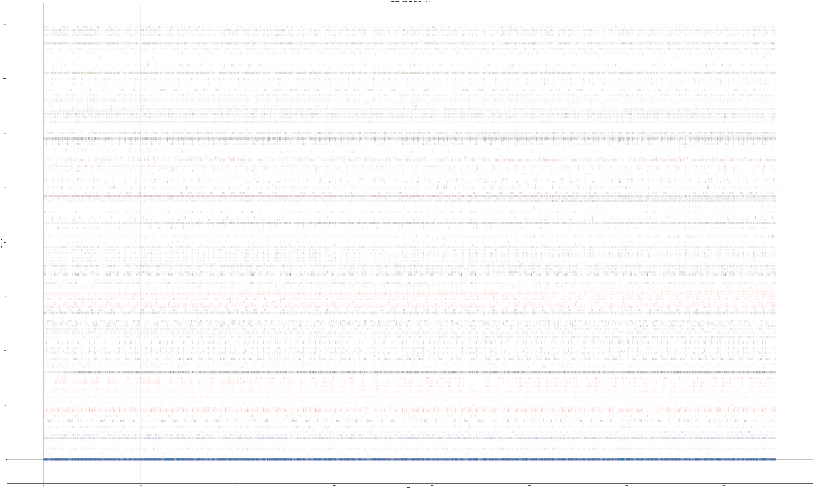
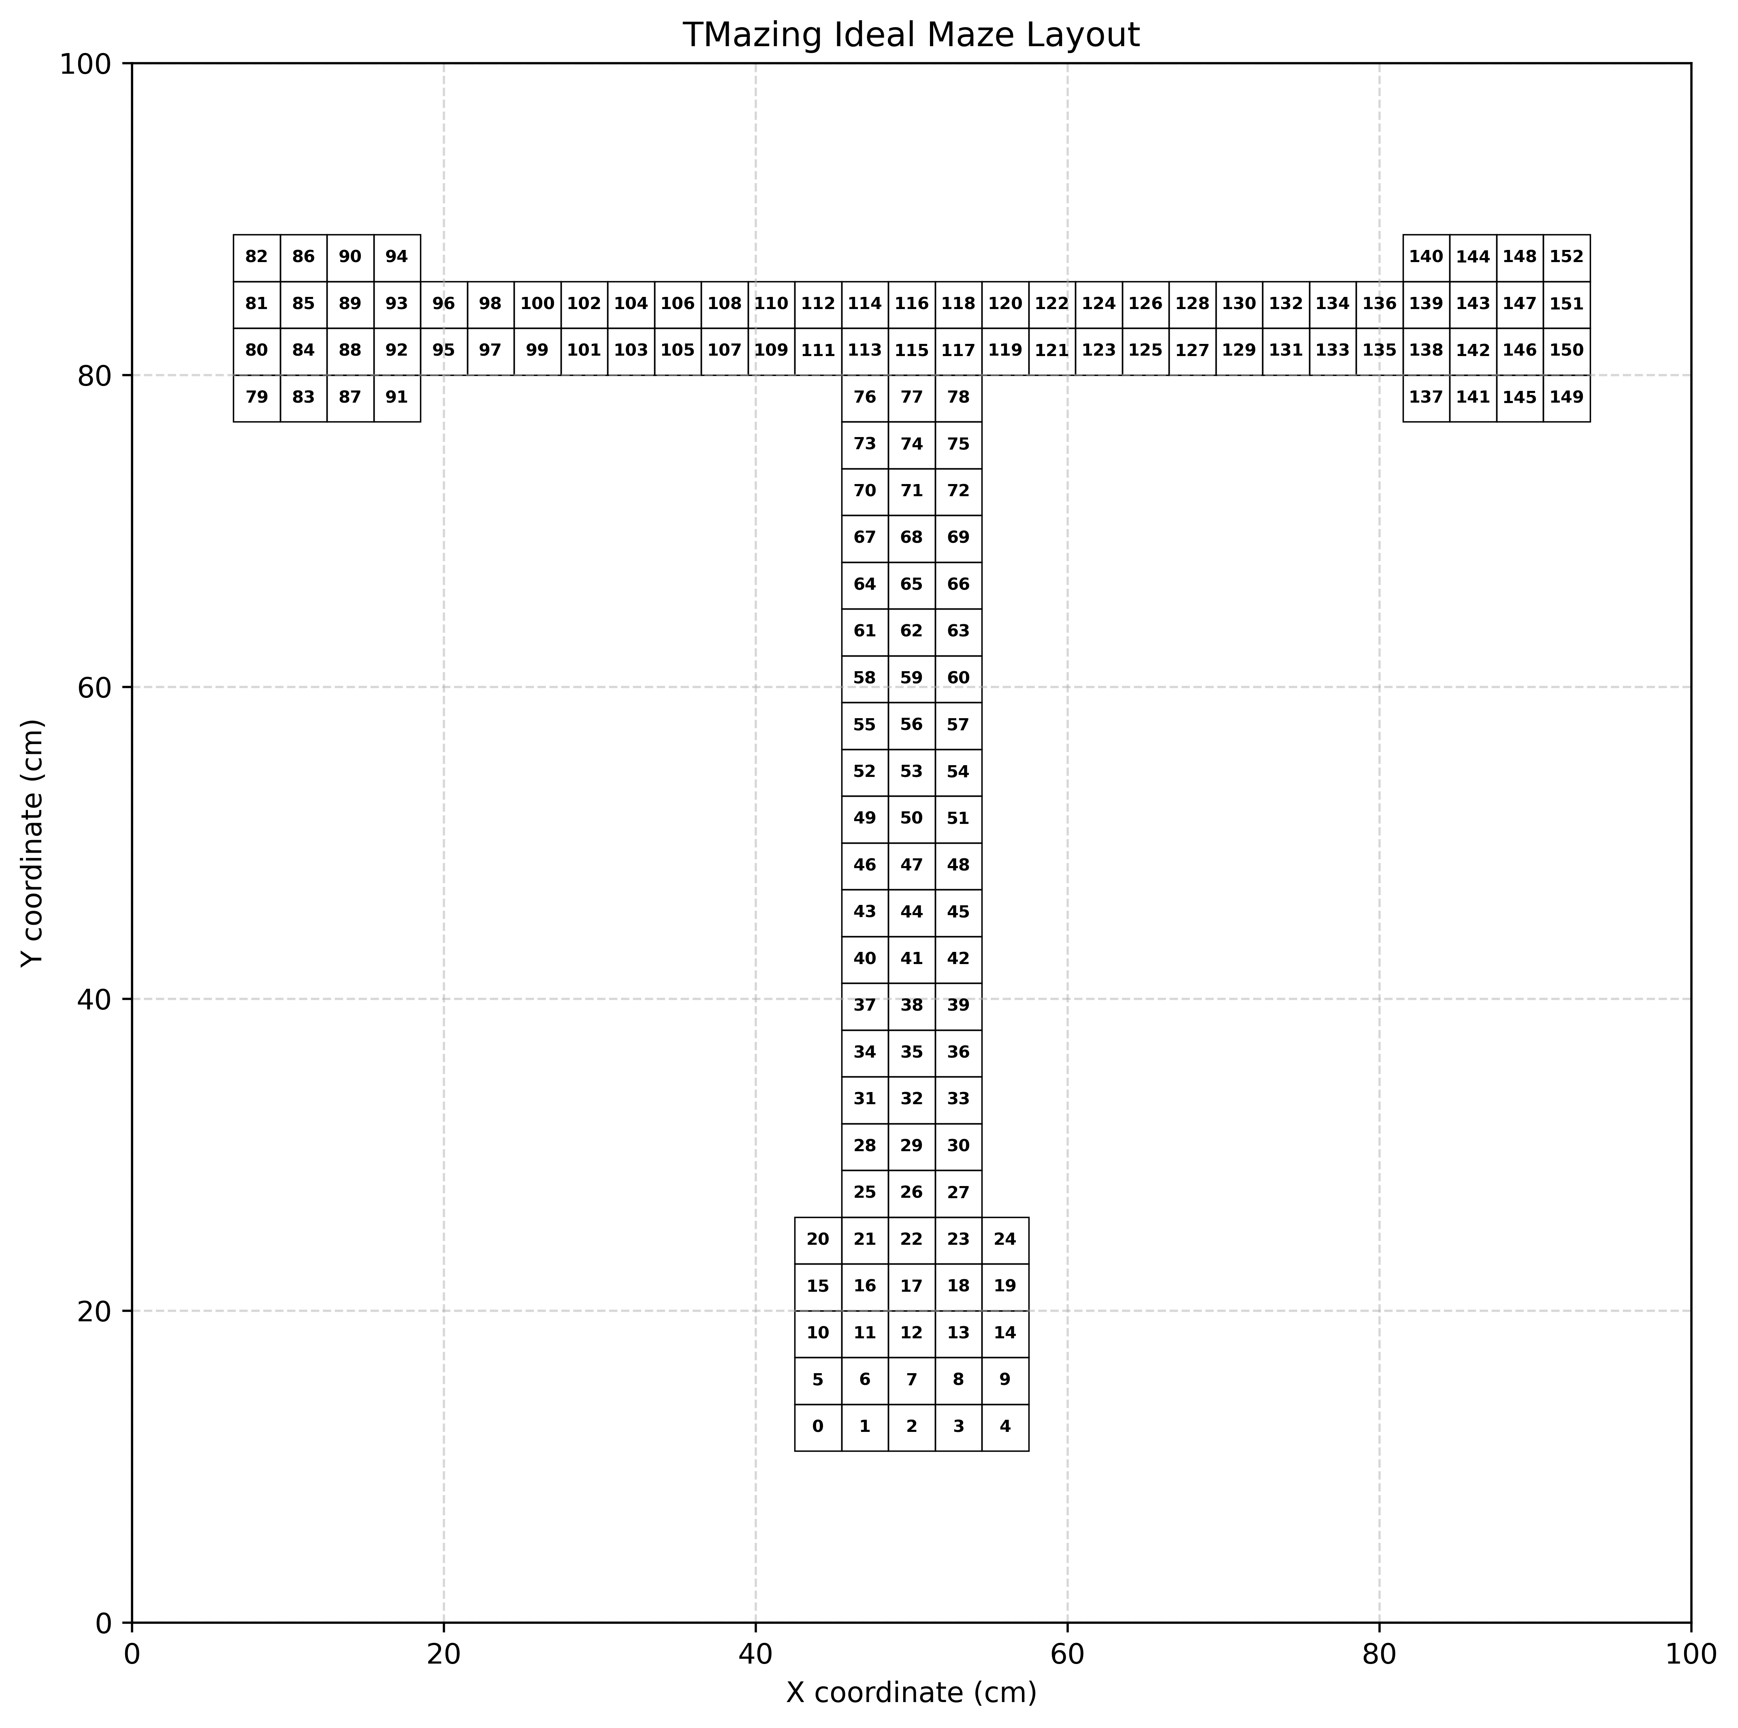

10 × 50ms
Data Augmentation
PV
Trajectory
Matrix
Embedding Layer
Attention Gating
Unit
Time
Batch Norm Layer
2 Layer MLP
Residual Connection
Elementwise Multiplication
Softmax
Unpacking
Residual Connection
LSTM
Final Hidden State
Layer Norm
6 LayerMLP
Relu Nonlinearity
Residual
Connection
Output
Restriction

Slide 2

Inbound
L-Reward
R-Reward
Outbound
Delay Box

Slide 3

Task
Sample

Slide 5

Task (DNMTS, 2AFC…)
Comparative Analysis
Animal Agent
Agent behavior
Neural activity & representation
Computational principle
Perturbations and lesions
Artificial Agent

Slide 6


A PO-MDP is defined by the tuple (S, A, T, R, Ω, O, γ)
Action a_{t} ~ π(s_{t})
State s_{t+1} ~ P(s_{t} , a_{t})
Observation o_{t} ~ O(s_{t} , a_{t})
Agent maps from observation to action
Reward r_{t} ~ R(s_{t} , a_{t})
Environmental dynamics is Markovian on state

Slide 7
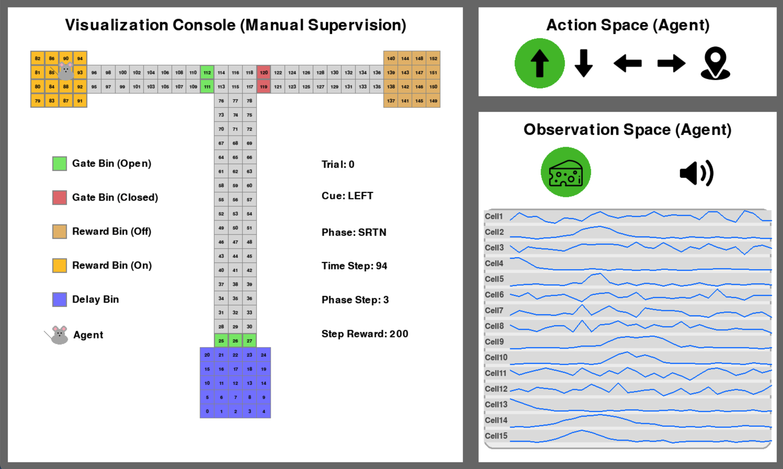

Slide 9
A PO-MDP is defined by the tuple (S, A, T, R, Ω, O, γ)
Action a_{t} ~ π(s_{t})
Dynamics is Markovian on State
Agent gets observation
State s_{t+1} ~ P(s_{t} , a_{t})
Agent Policy π
Observation o_{t} ~ O(s_{t} , a_{t})
Reward r_{t} ~ R(s_{t} , a_{t})
Environment
An MDP is defined by the tuple (S, A, P, R, γ)
Action a_{t} ~ π(s_{t})
Dynamics is Markovian on State
Agent gets full state
State s_{t+1} ~ P(s_{t} , a_{t})
Agent Policy π
Reward r_{t} ~ R(s_{t} , a_{t})
Environment

Slide 10

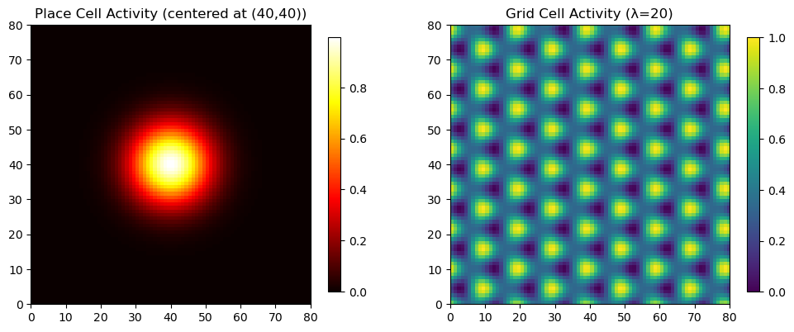




TMazing PO-MDP Simulation
Taste Perception
Place Cell / Grid Cell Simulation
Audio Perception
Spatial Perception
State t
Observation Space
O_{t-1}
O_{t}
A_{t}
History of Observations
Agent/Policy
Action
Space
State t+1

Slide 11
TMazing PO-MDP Simulation
Taste Perception
Place Cell / Grid Cell Simulation
Audio Perception
Spatial Perception
State t
Observation Space
O_{t-1}
O_{t}
A_{t}
History of Observations
Agent/Policy
Action
Space
State t+1

Slide 12
10 × 50ms
PV
Trajectory
Matrix
Unit
Time
10 × 50ms
PV
Trajectory
Matrix
Unit
Time

Slide 13
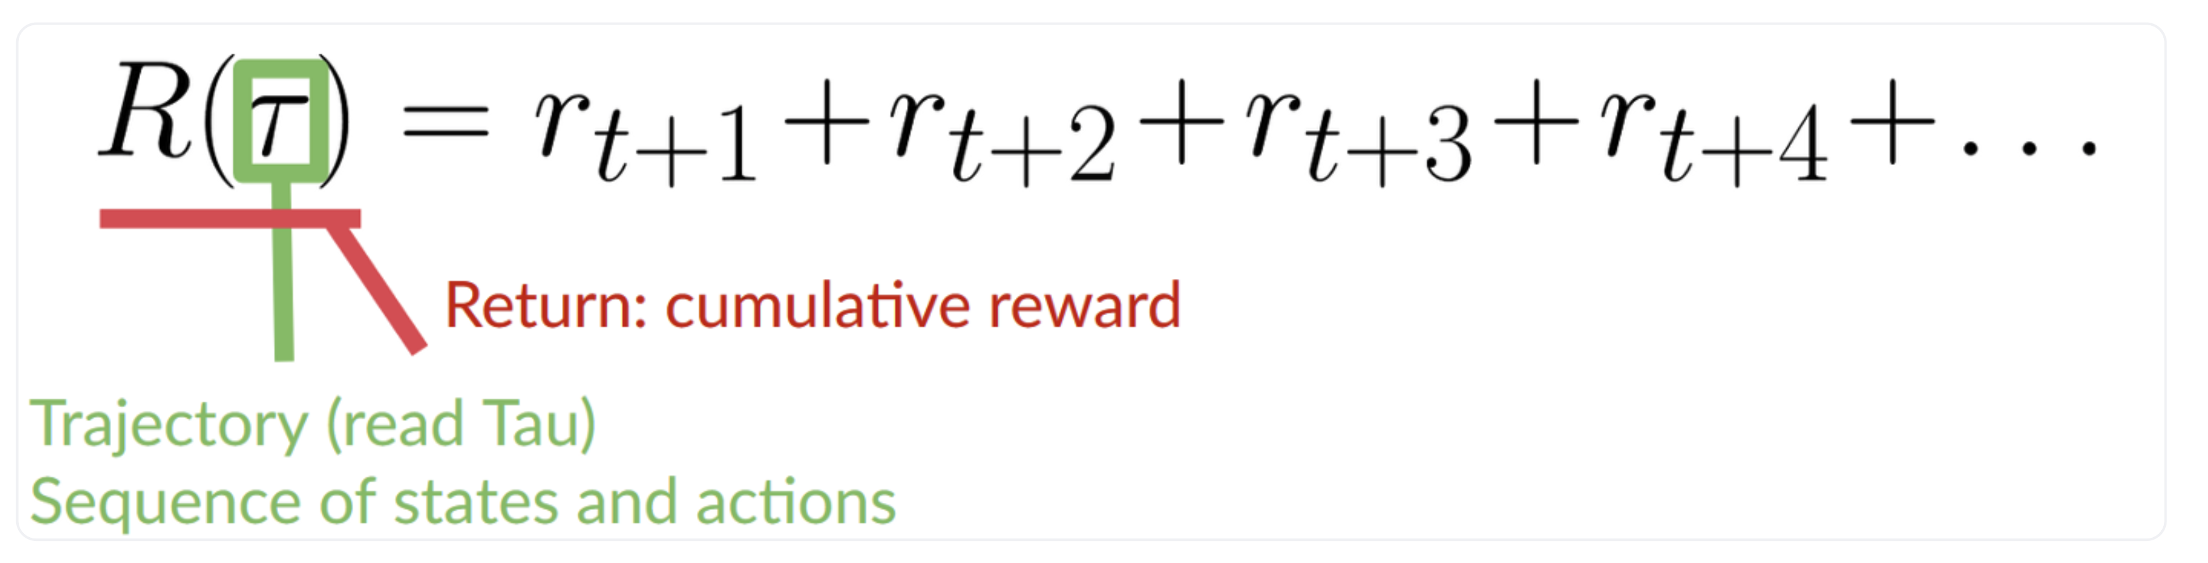
Action
Observation
Agent
Reward
Environment

Slide 14
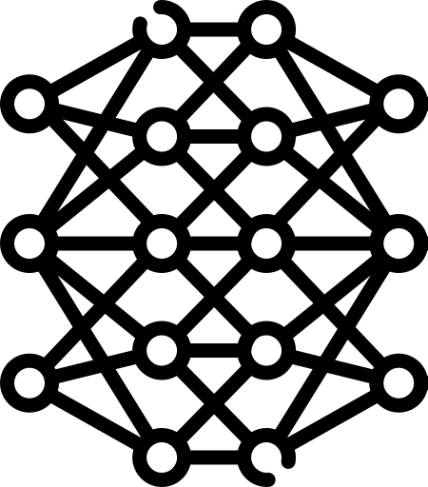
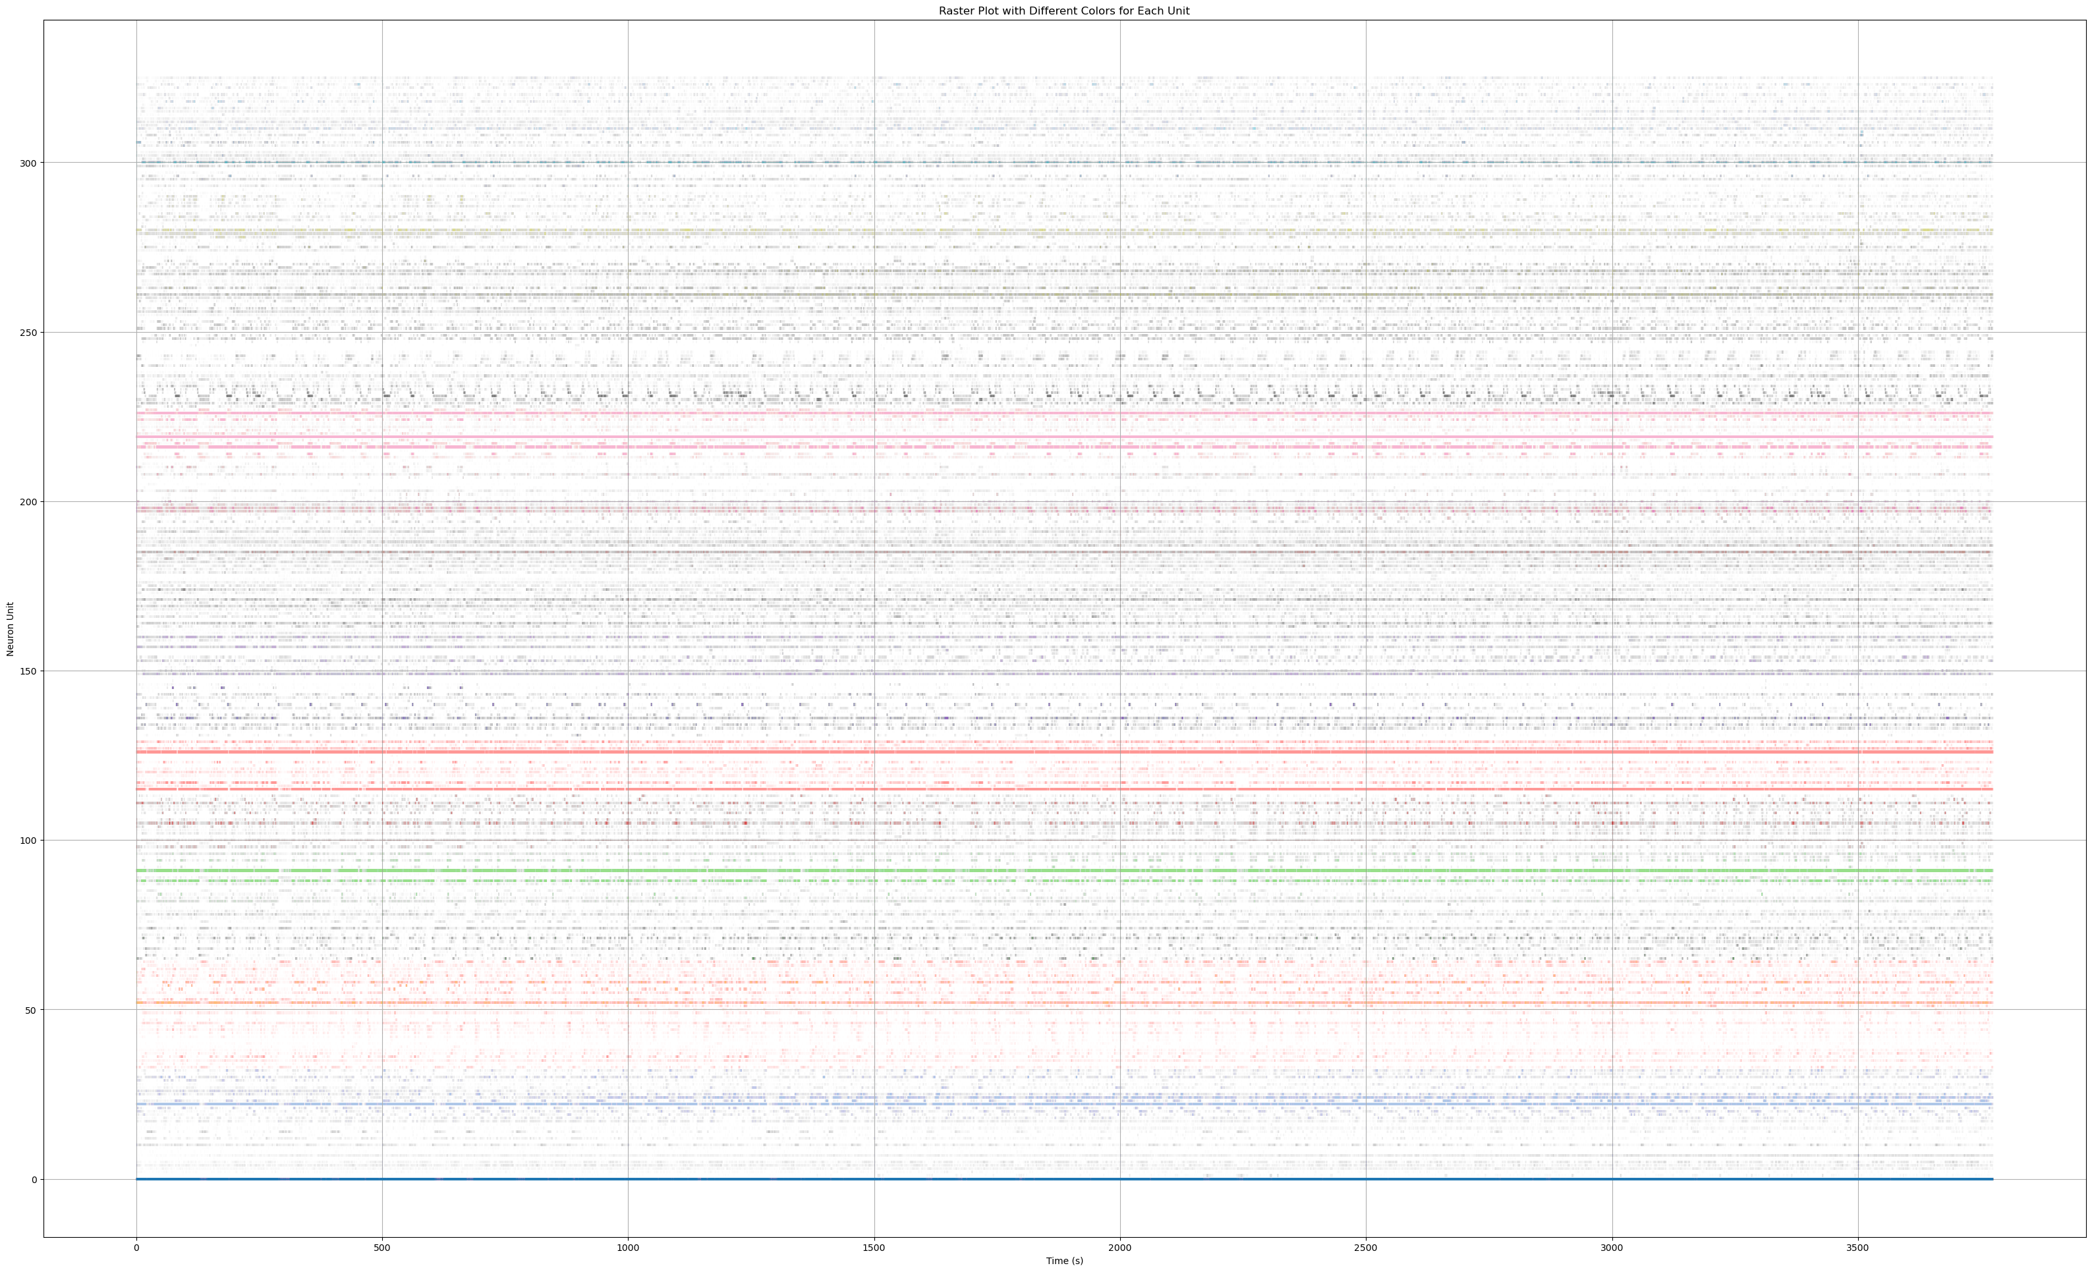
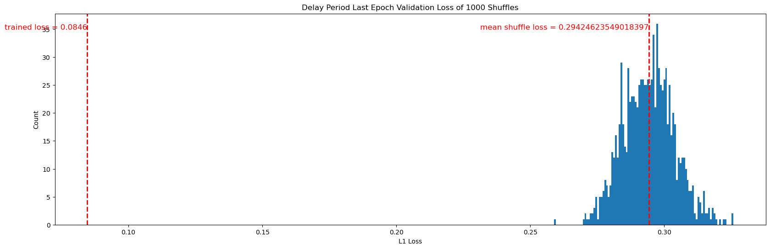
HPC PV
MLP Model
mPFC PV
Comparing mapping loss against shuffle reveals correlation in the activity patterns of the two regions during delay phase.

Slide 15
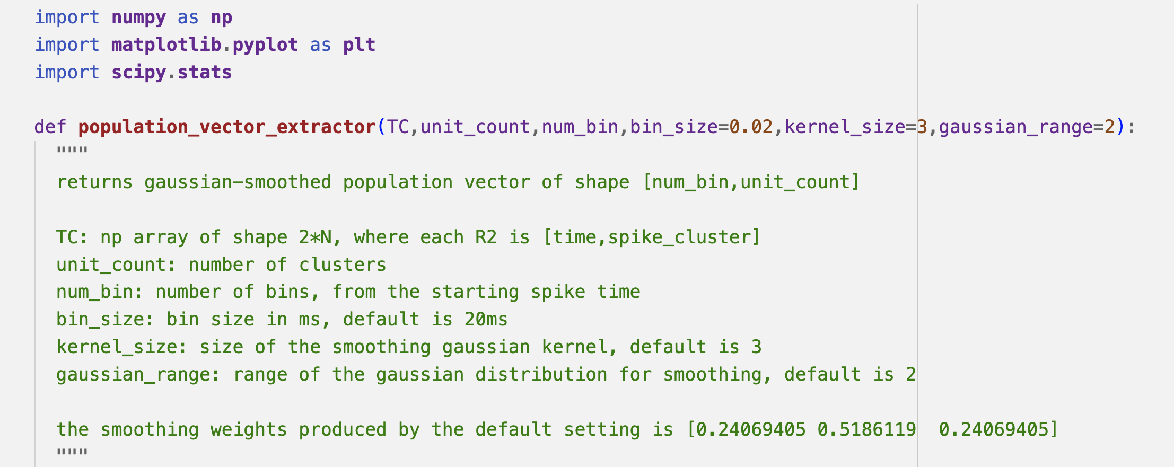

Slide 16
MLP Translation
HPC PV (Time-locked)
PFC PV (Time-locked)

Slide 17
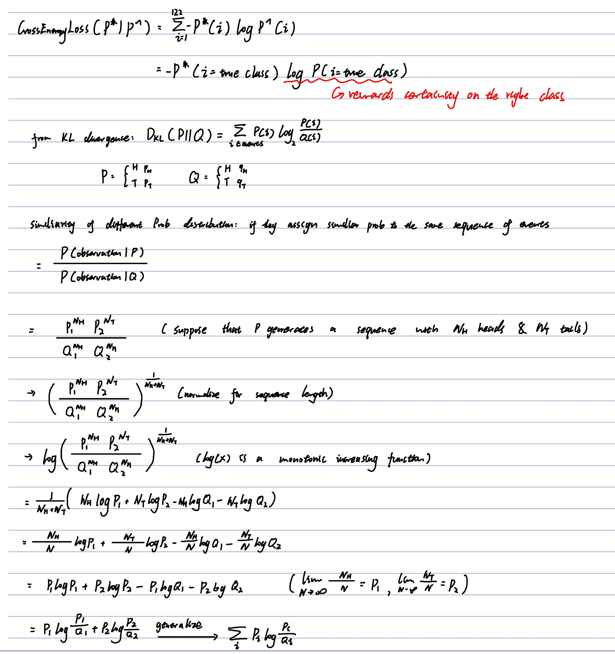
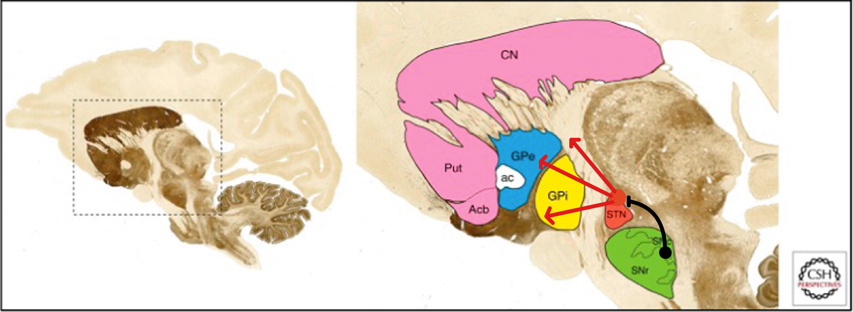
1. Retrograde expression of Cre Recombinase: AAVretro-hSyn-Cre-WPRE (AAV1)
2. Expression of TVA Viral Receptor and GFP: AAV8-hSyn-FLEX-TVA-P2A-GFP-P2A-oG (AAV2)
3. Retrograde expression of rabies virus with mCherry reporter gene: EnvA-G-deleted-RV-mCherry (R1)
EnvA-G-deleted-RV-mCherry
AAV8-hSyn-FLEX-TVA-P2A-GFP-P2A-oG
AAVretro-hSyn-Cre-WPRE

Slide 18
1. Retrograde expression of Cre Recombinase: AAVretro-hSyn-Cre-WPRE (AAV1)
2. Expression of TVA Viral Receptor and GFP: AAV8-hSyn-FLEX-TVA-P2A-GFP-P2A-oG (AAV2)
3. Retrograde expression of rabies virus with mCherry reporter gene: EnvA-G-deleted-RV-mCherry (R1)
EnvA-G-deleted-RV-mCherry
AAV8-hSyn-FLEX-TVA-P2A-GFP-P2A-oG
AAVretro-hSyn-Cre-WPRE

Slide 19
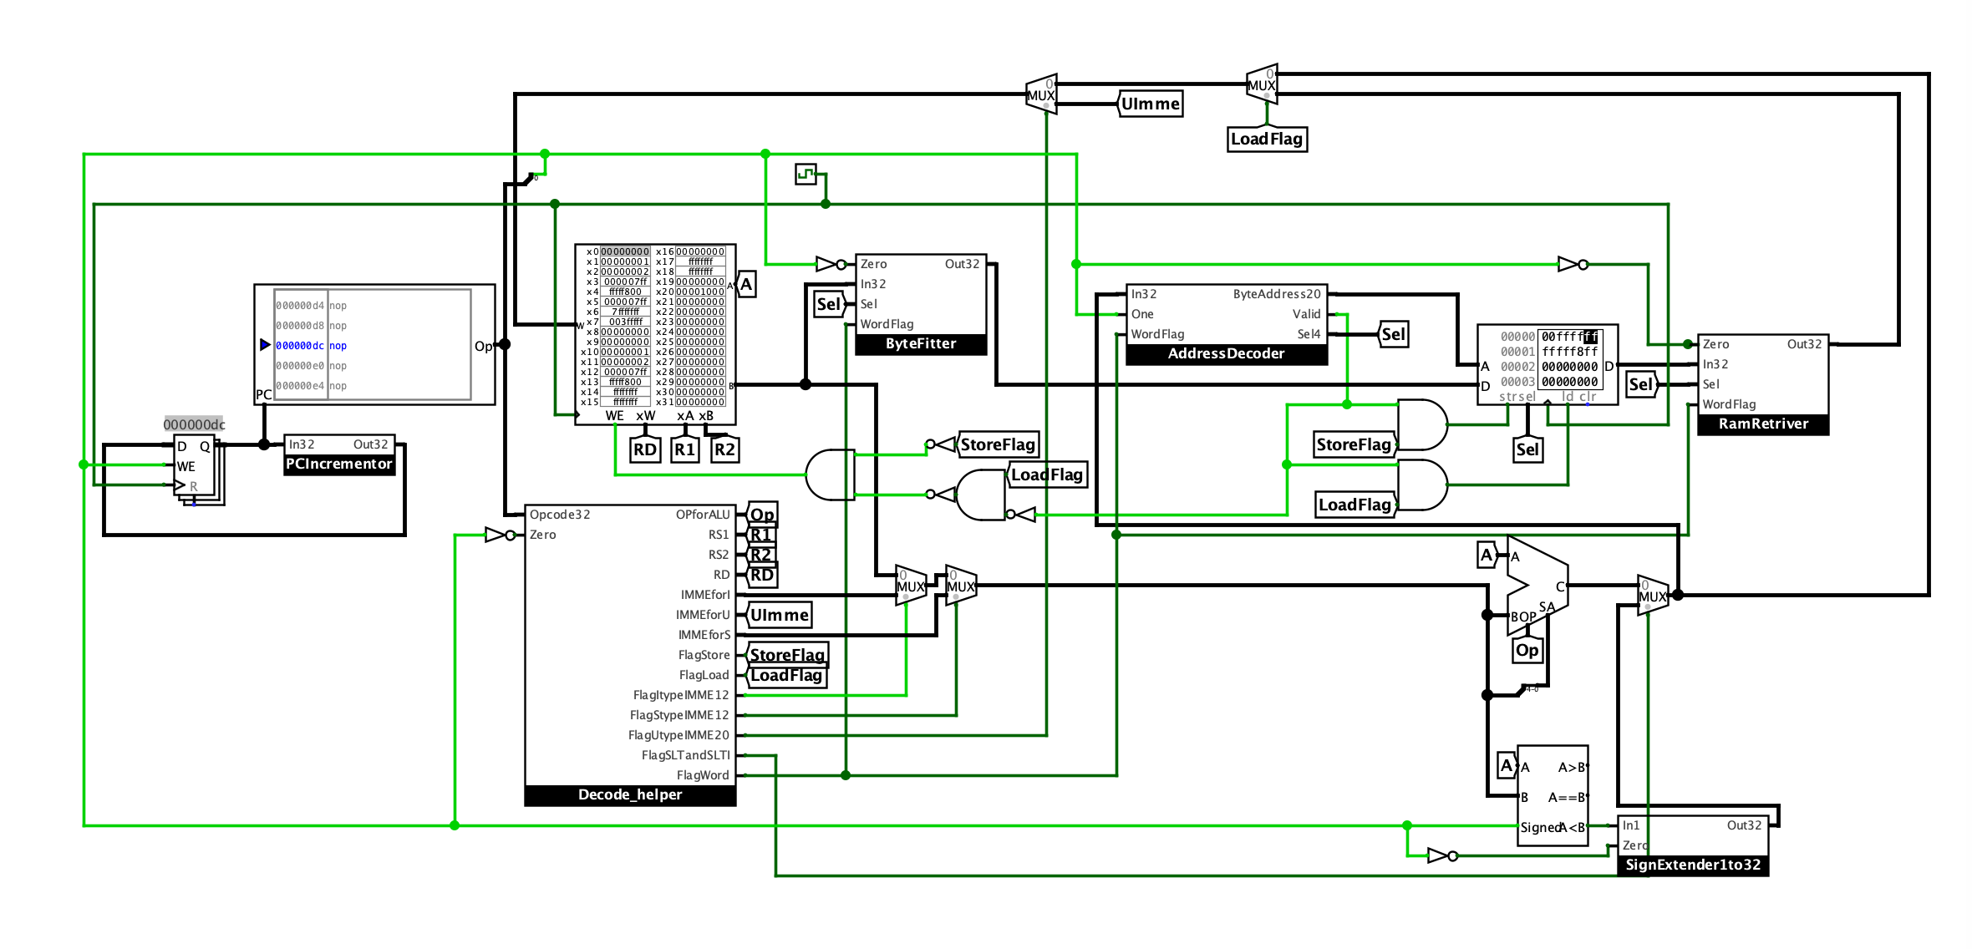

Slide 21
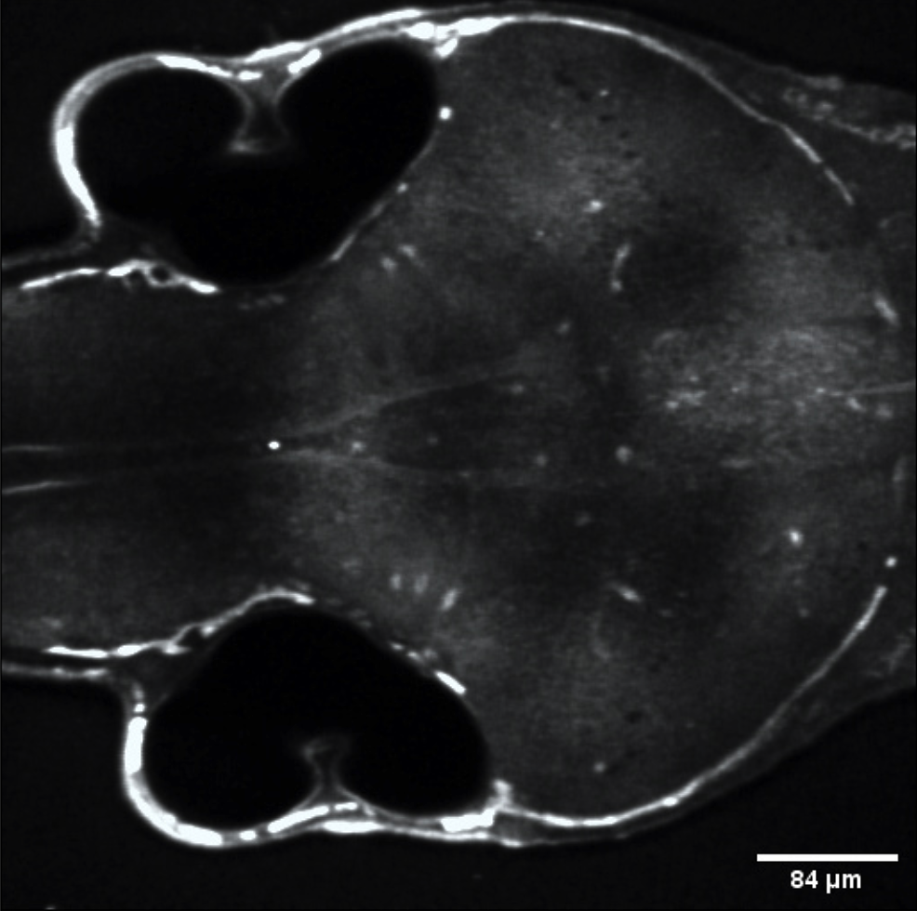
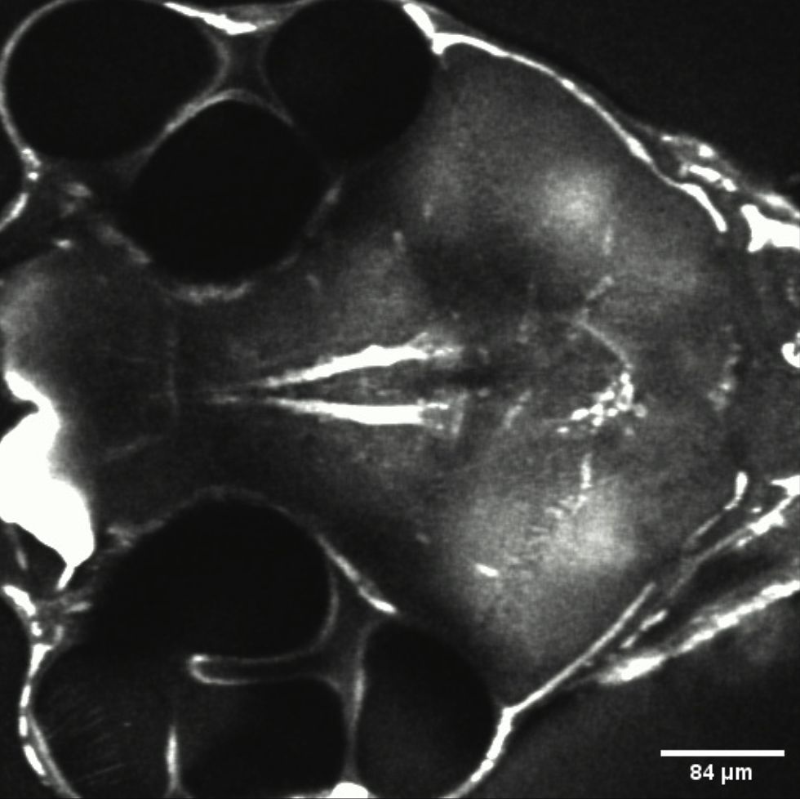
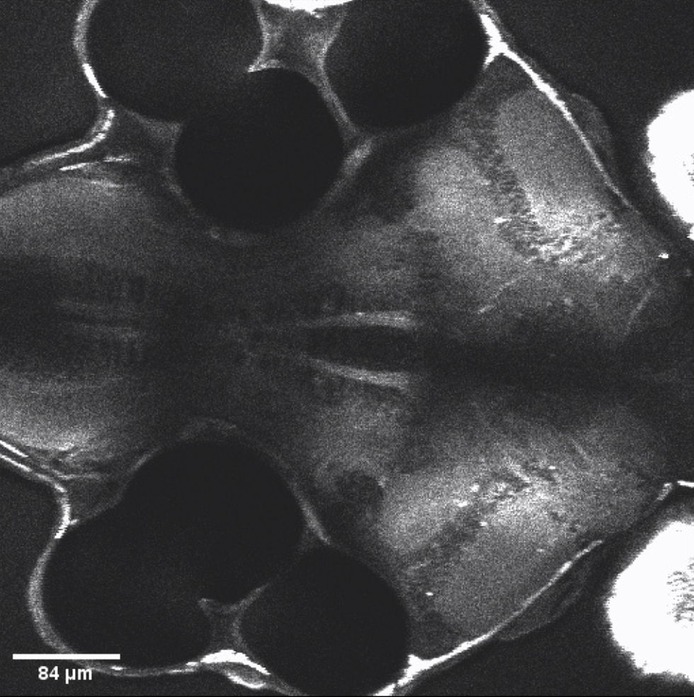
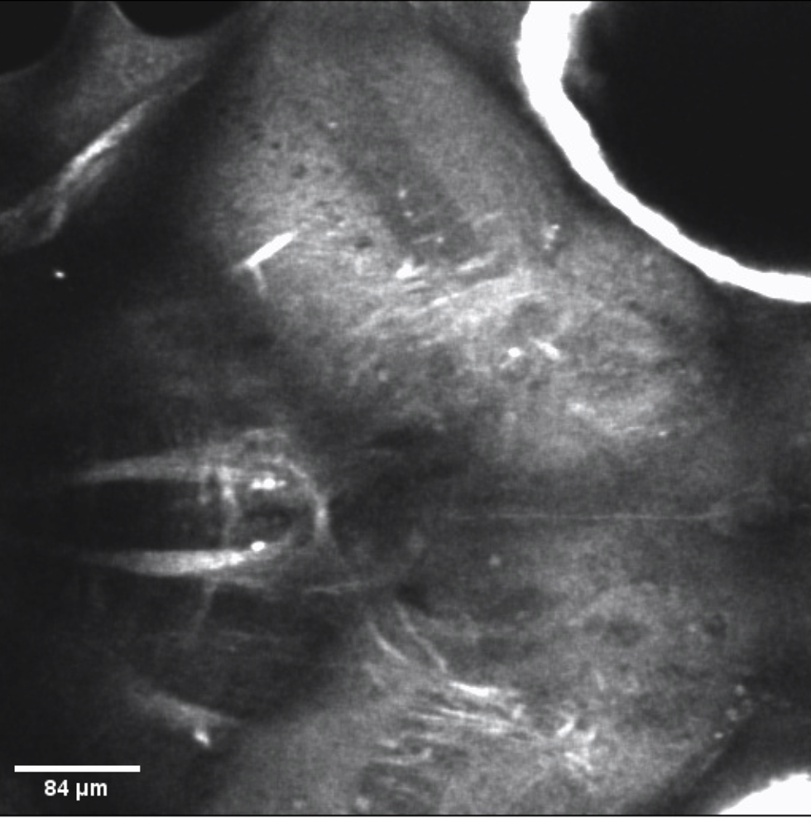
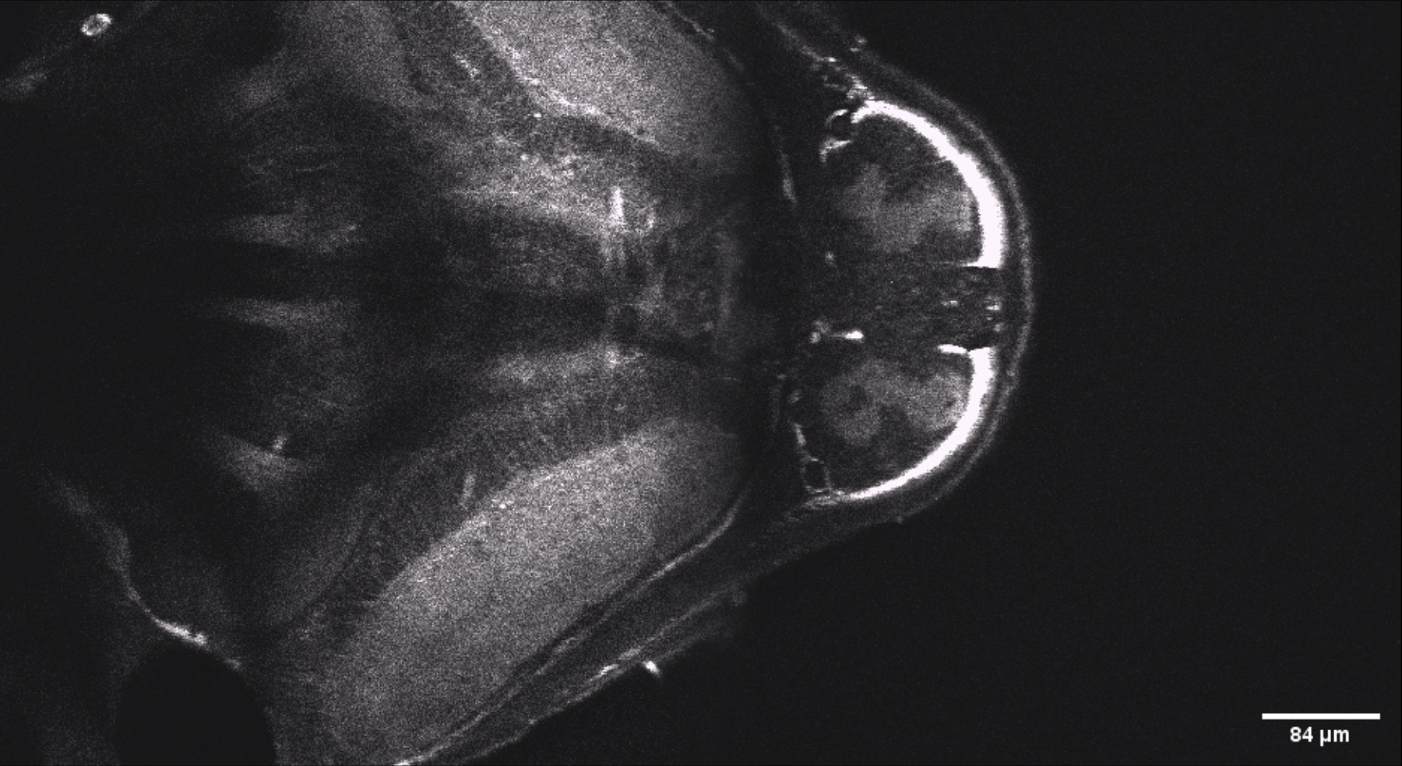
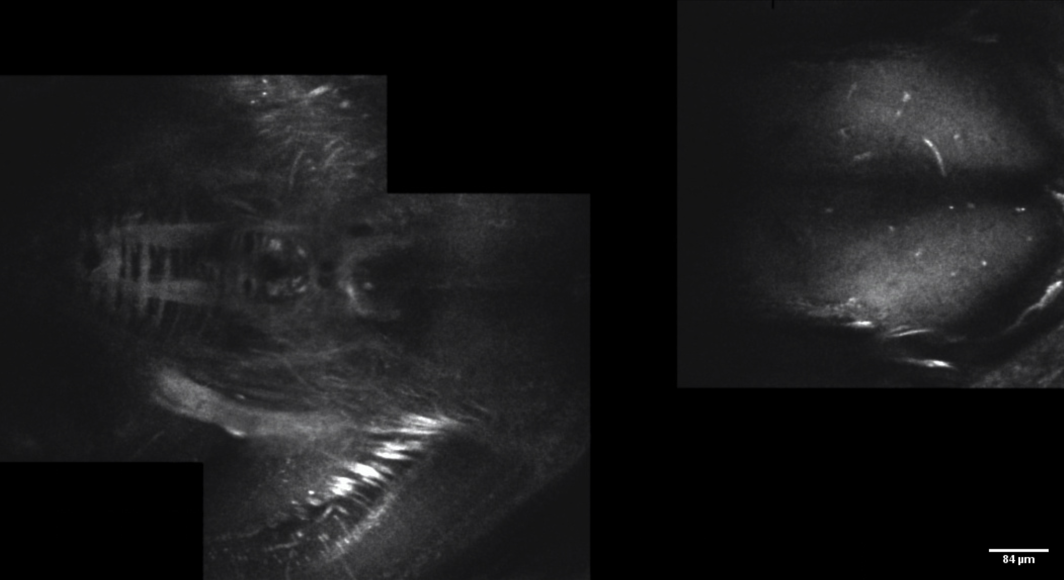
Ear Chamber
Ear Chamber
Ear Chamber
Eye
Ear Chamber
Hind Brain
Hind Brain
Hind Brain
Hind Brain
Mesencephalon
Mesencephalon
Mesencephalon
Mesencephalon
5 dpf
14 dpf
21 dpf
30 dpf
Hind Brain
Telencephalon
Hind Brain
Telencephalon
Mesencephalon
Mesencephalon
60 dpf
90 dpf

Slide 22
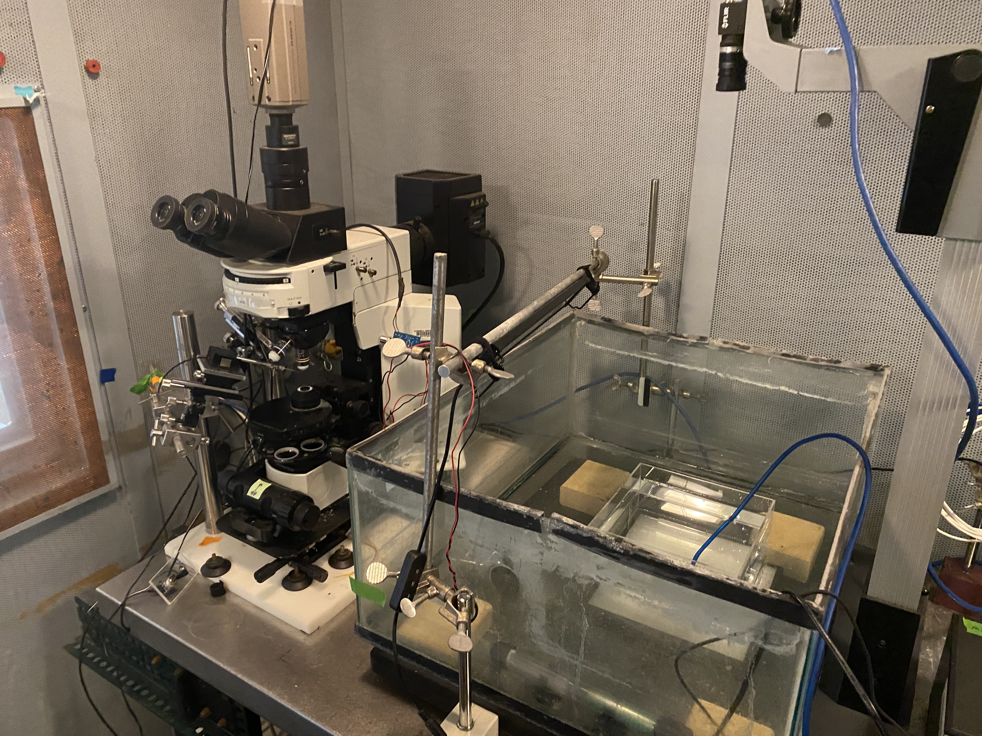
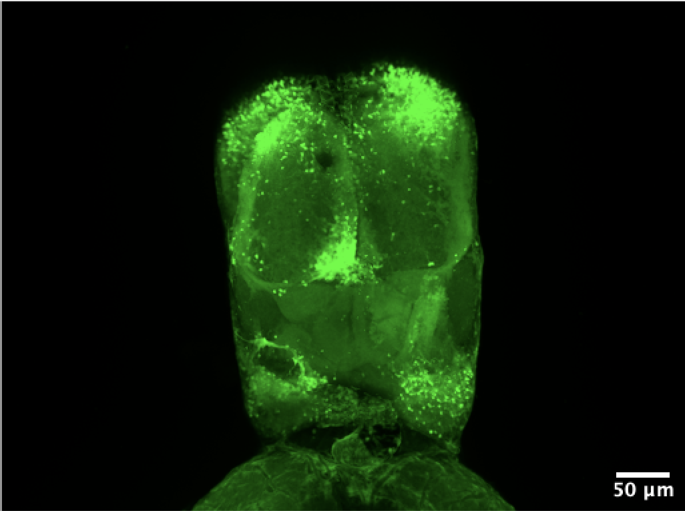
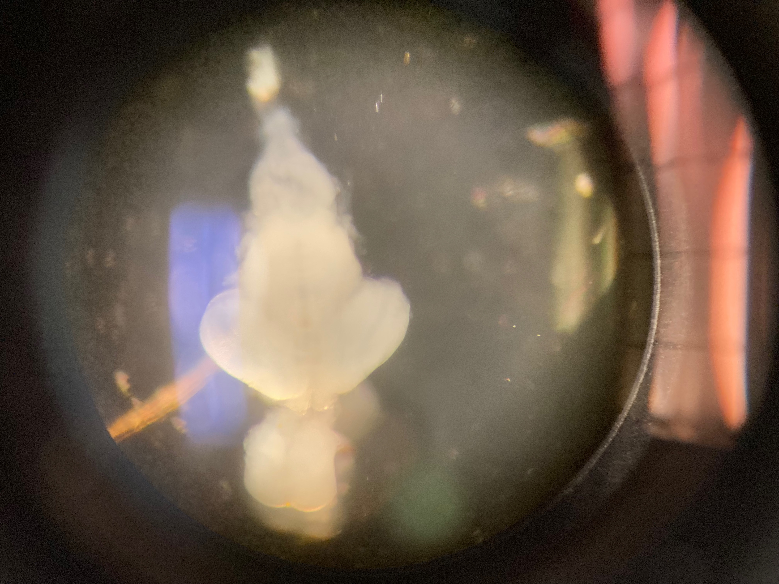

Slide 23
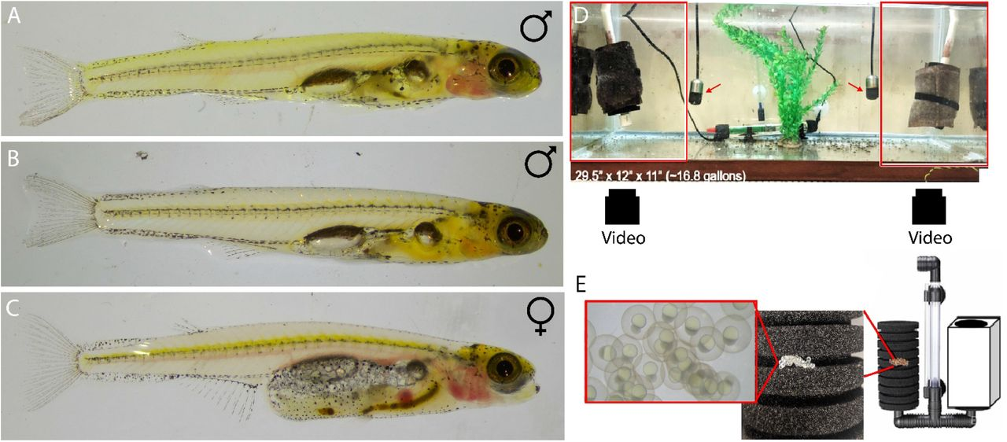
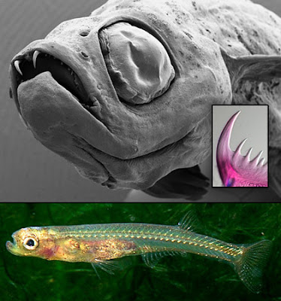

Slide 24
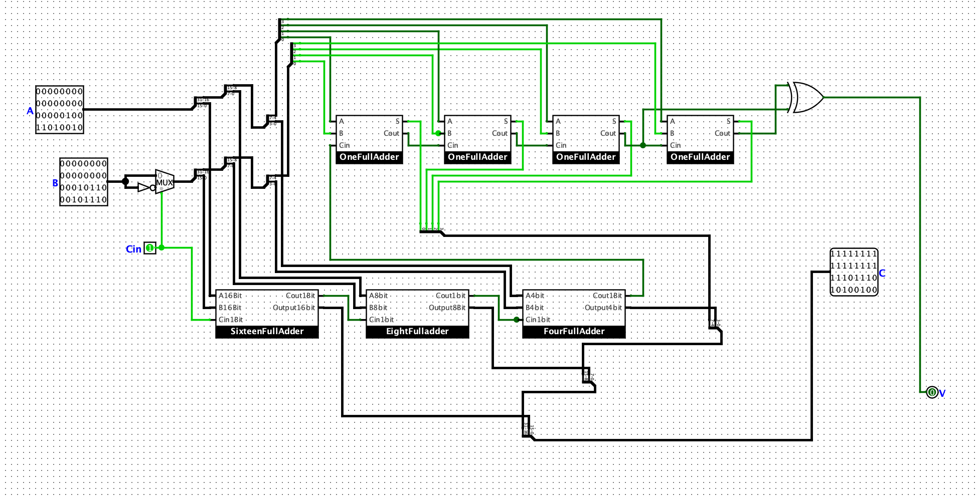
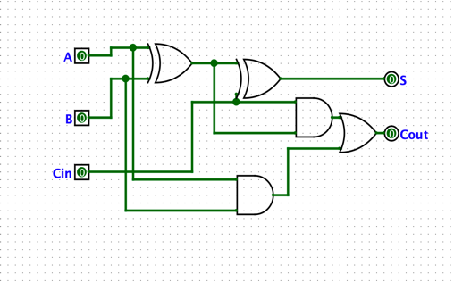

Slide 25
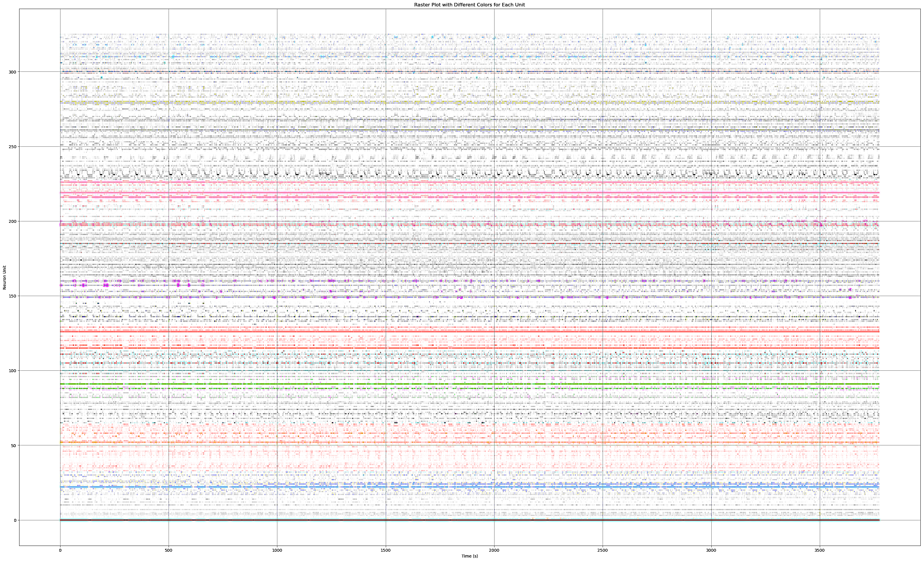

Slide 28
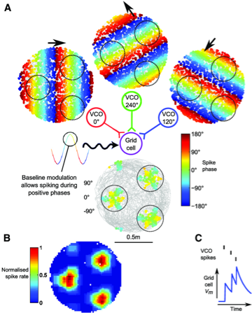
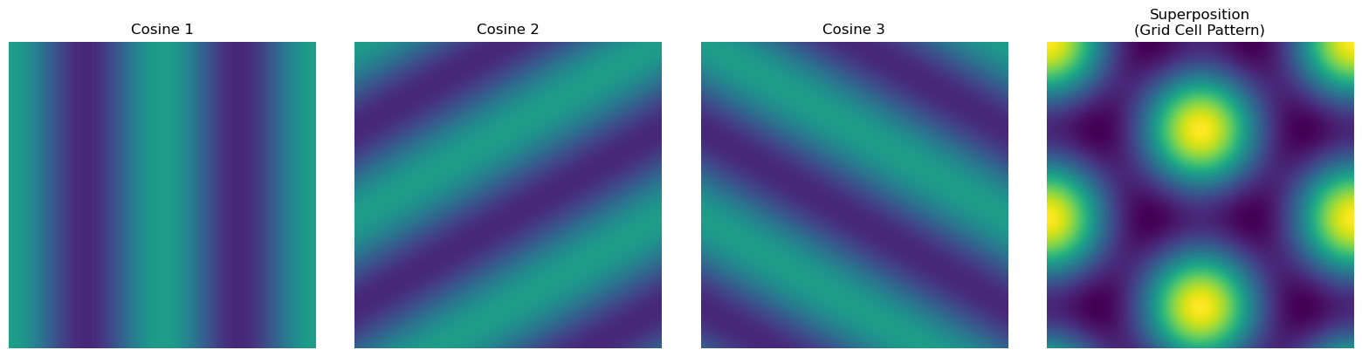

Slide 29
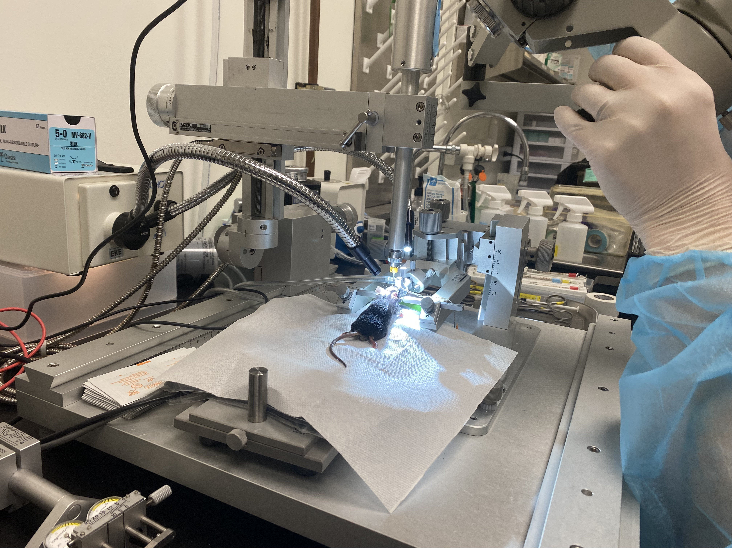
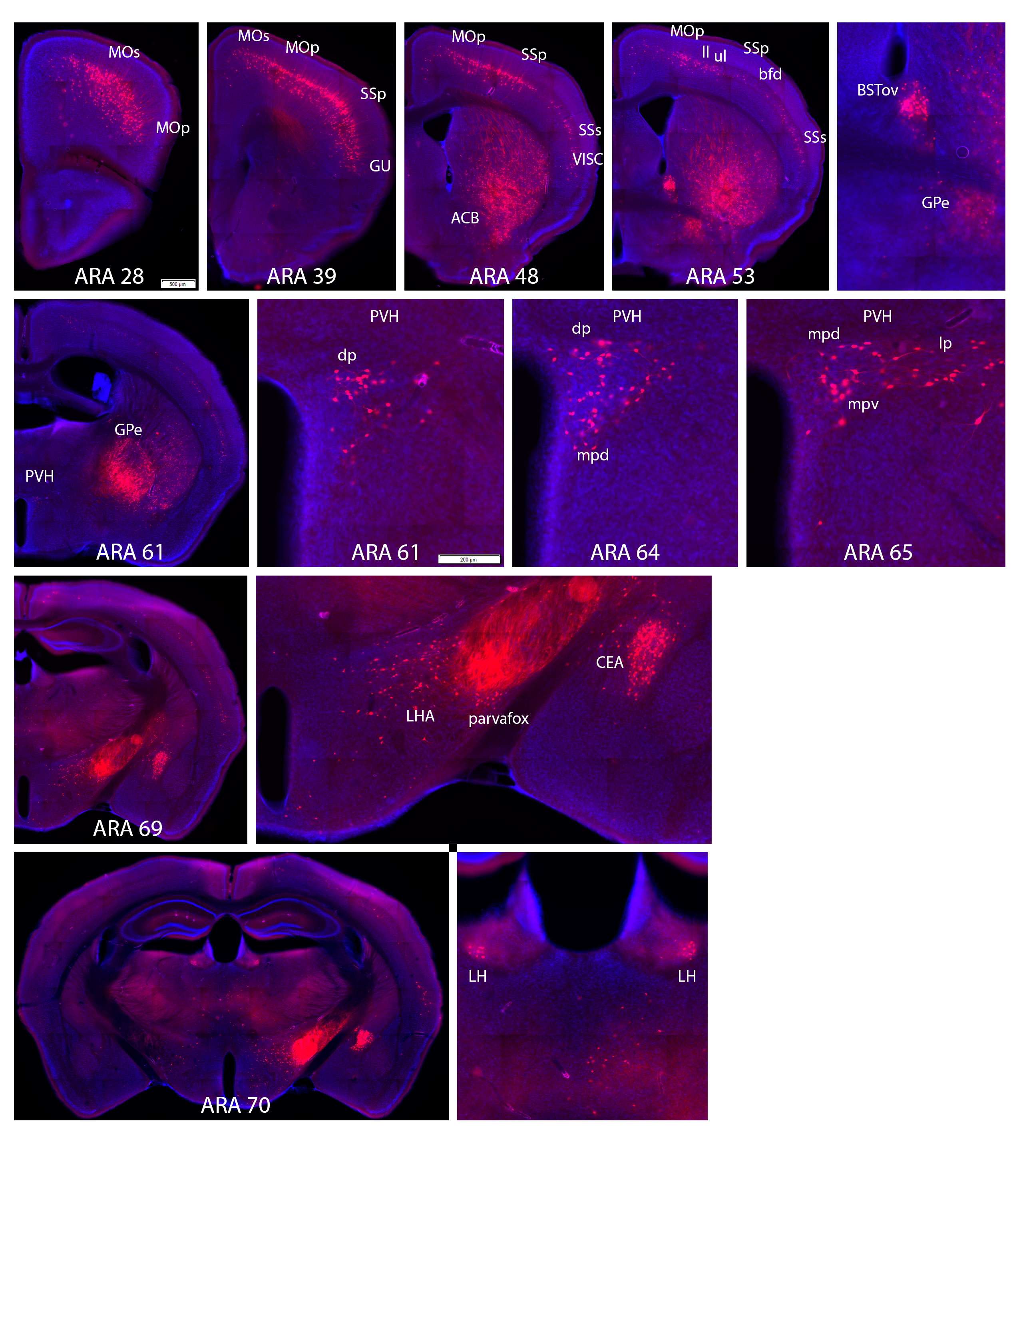
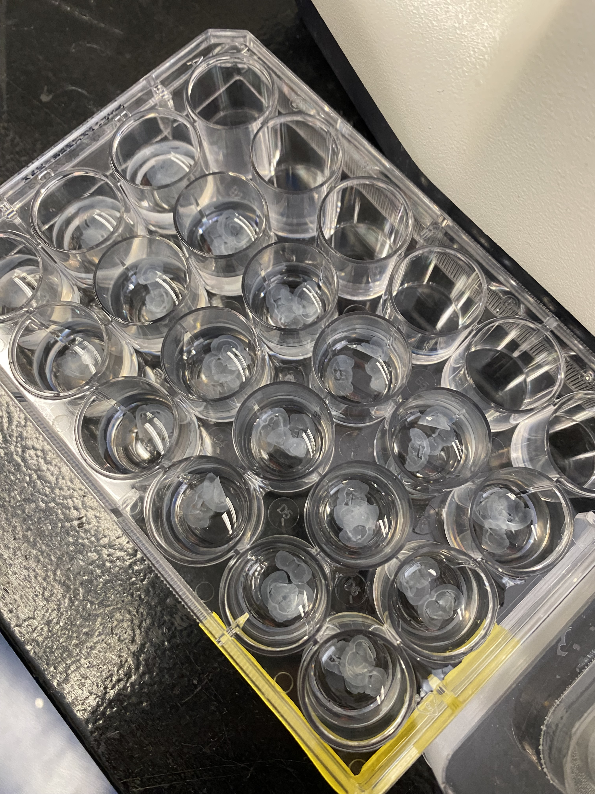
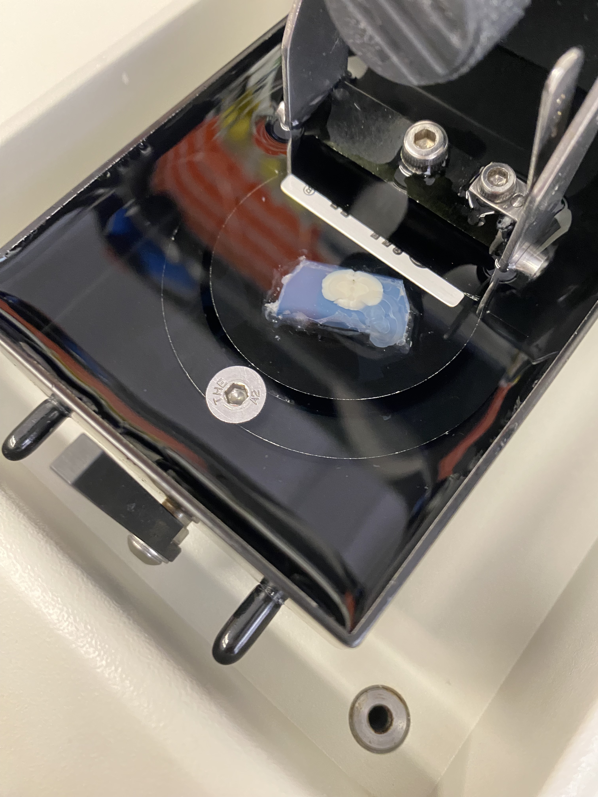
Tracer Injection
Vibratome Slicing
IHC
Microscopy Imaging

Slide 30
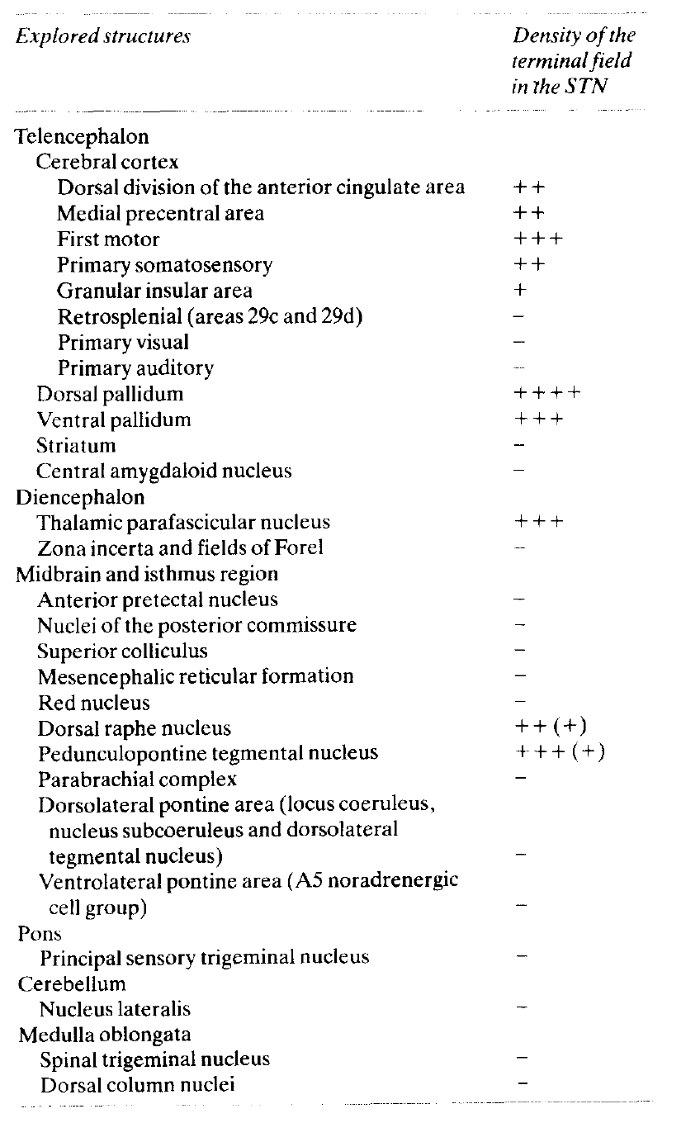
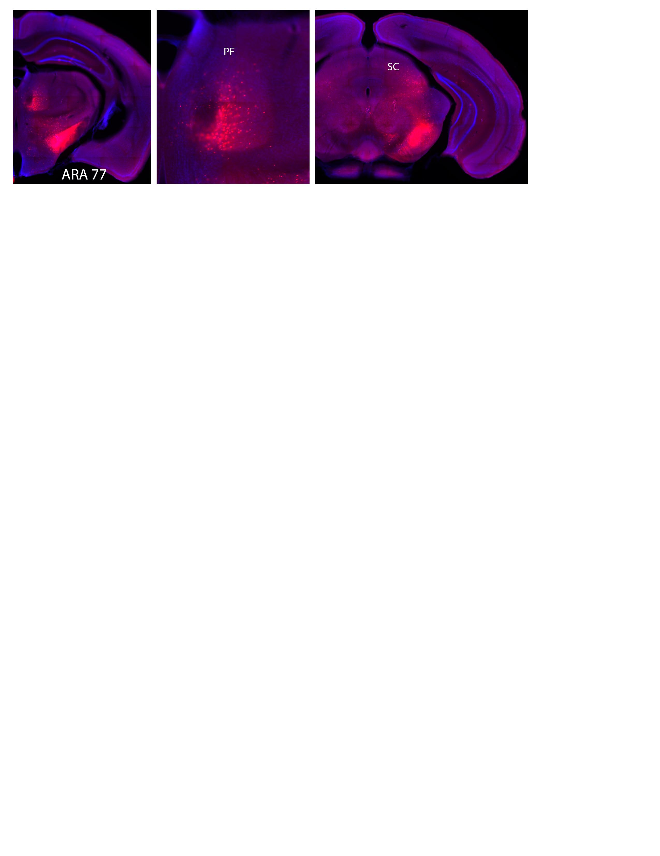
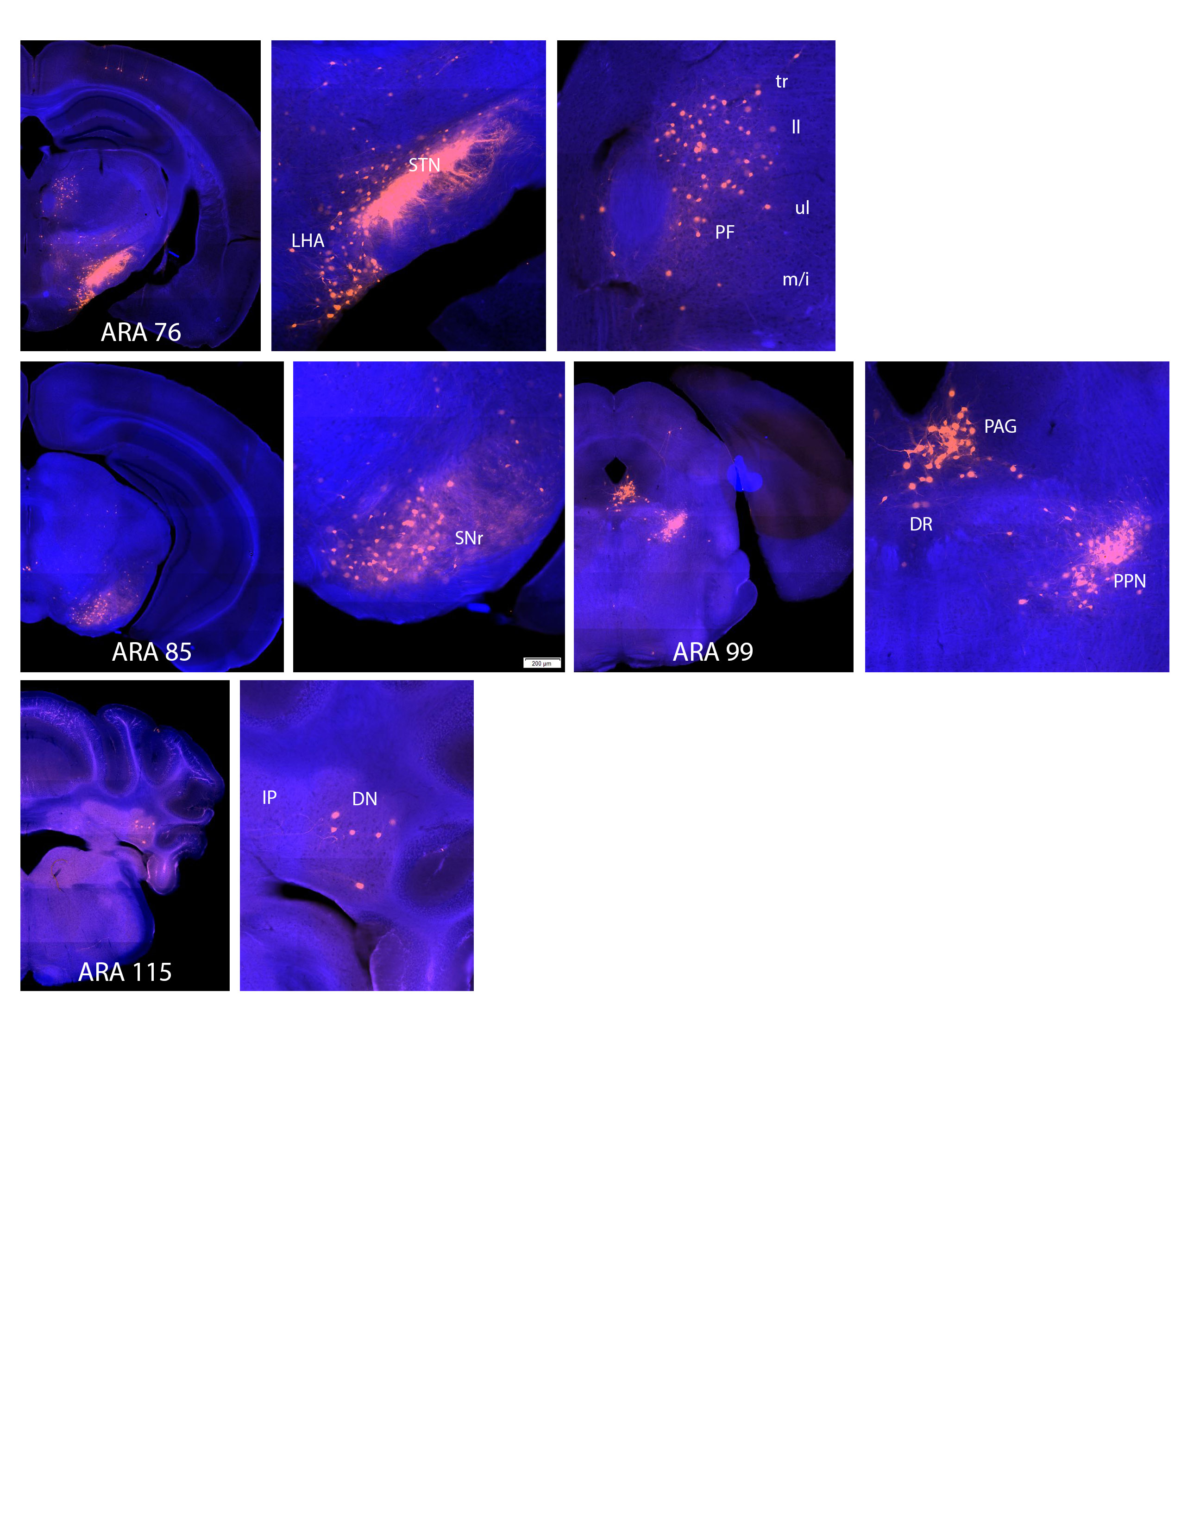
Confirming Established Structures

Slide 31
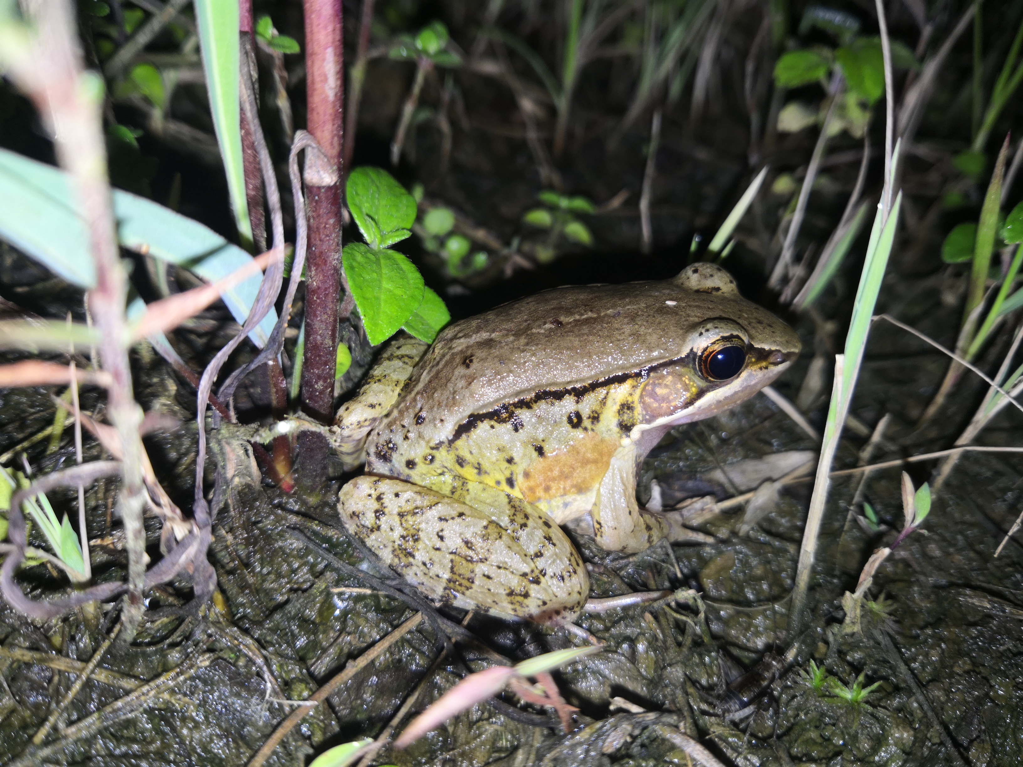
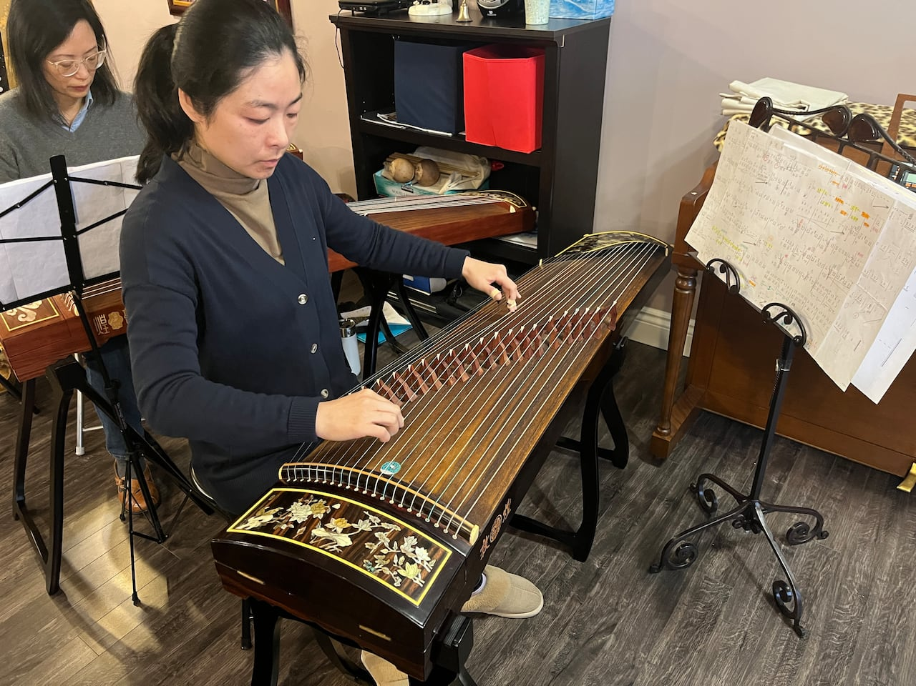
Guzheng, a traditional Chinese musical instrument

Slide 32
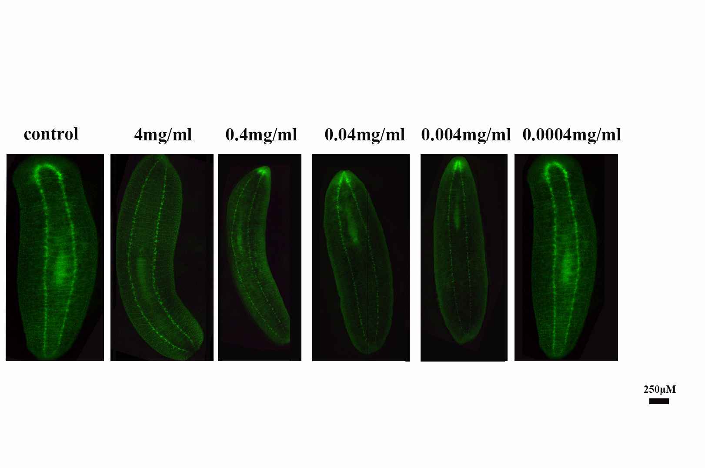

Slide 33
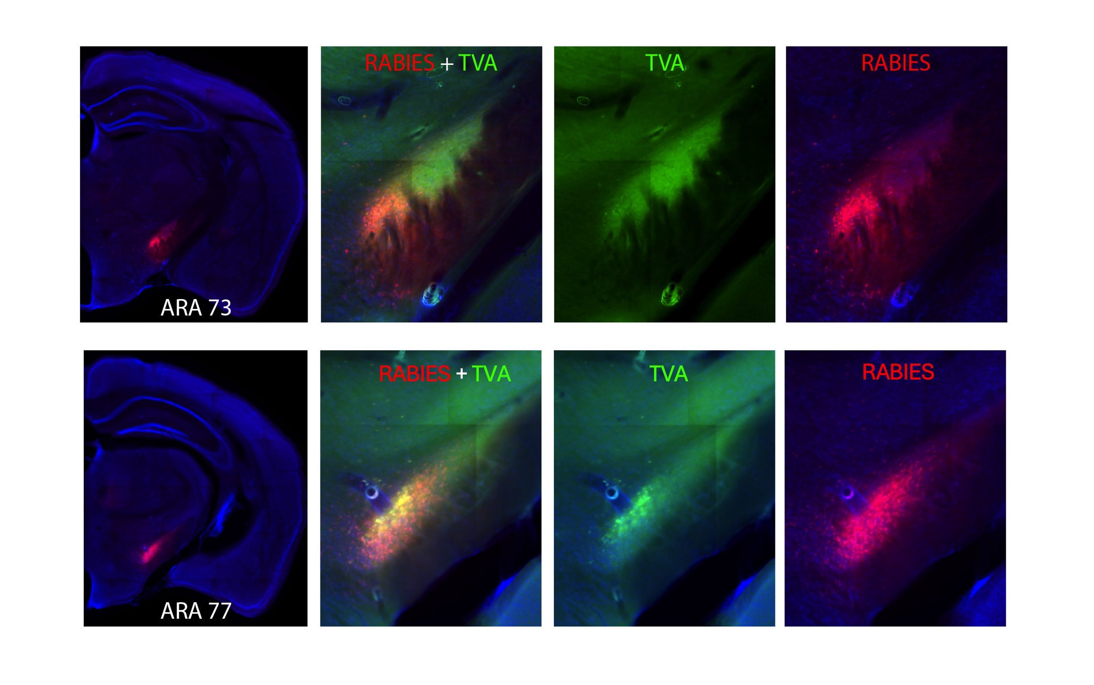

Slide 34
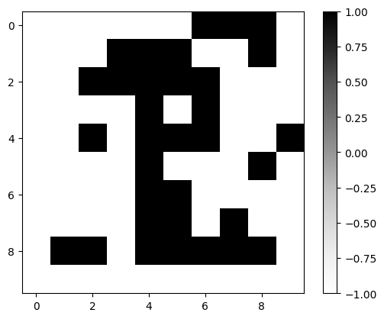
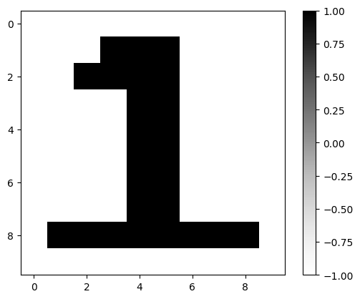
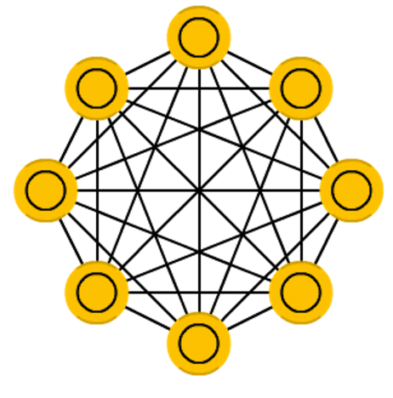
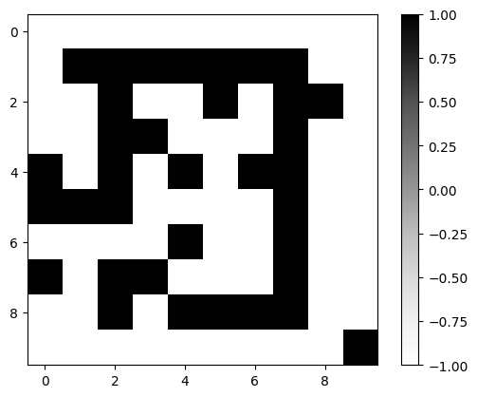
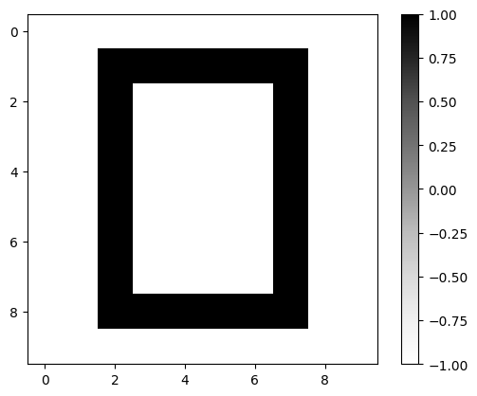
Pattern Recovery
Hopfield
Network
Pattern Recovery

Slide 35
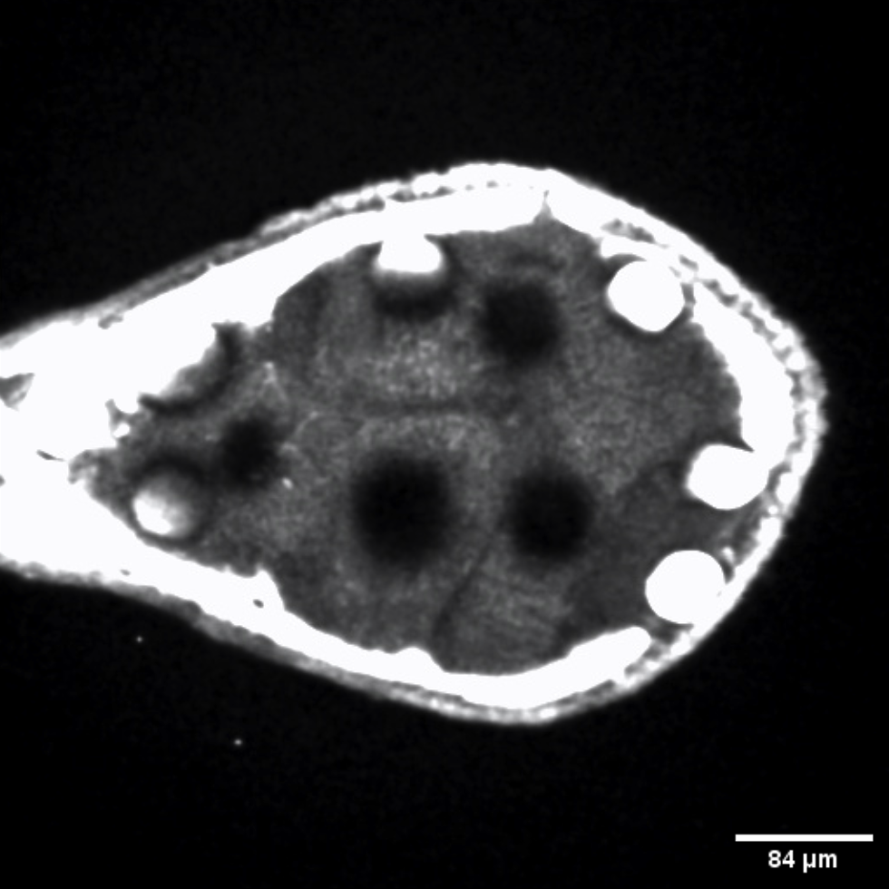
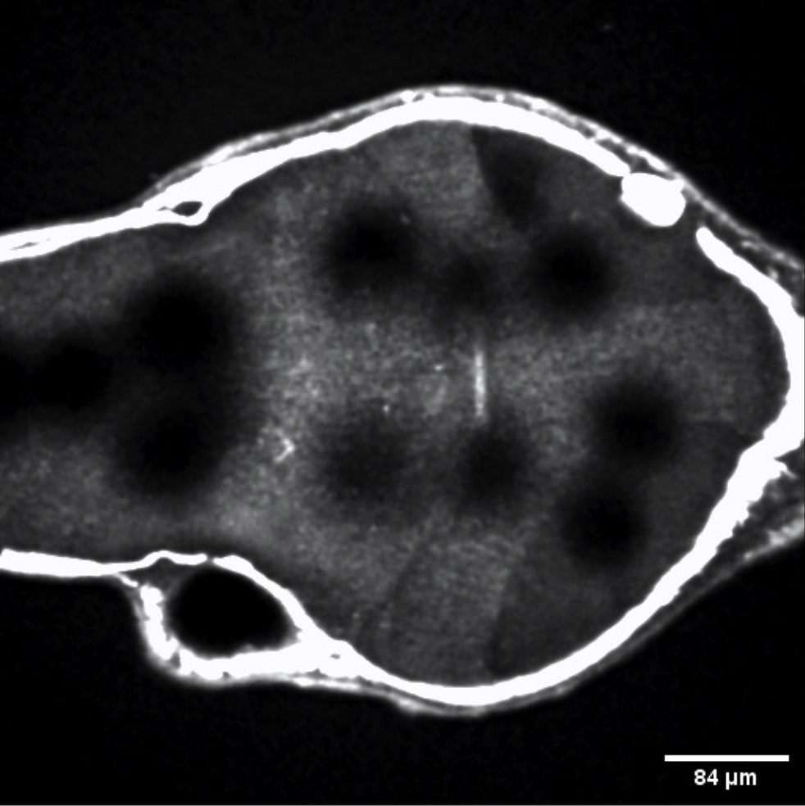
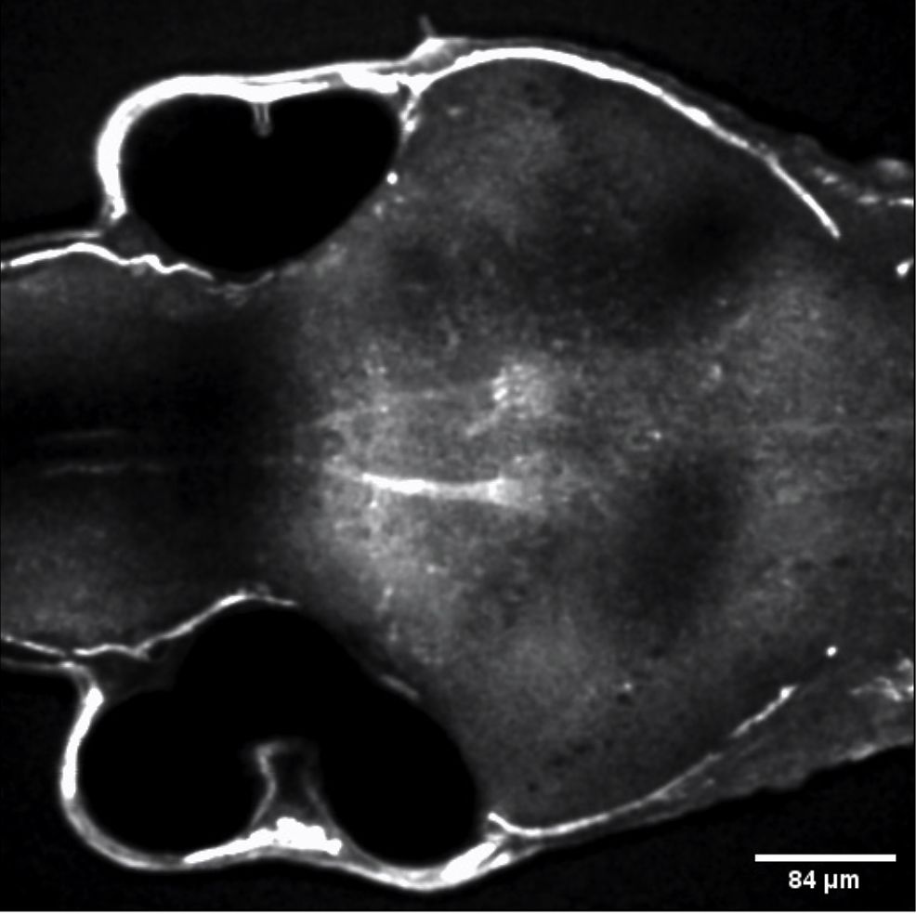
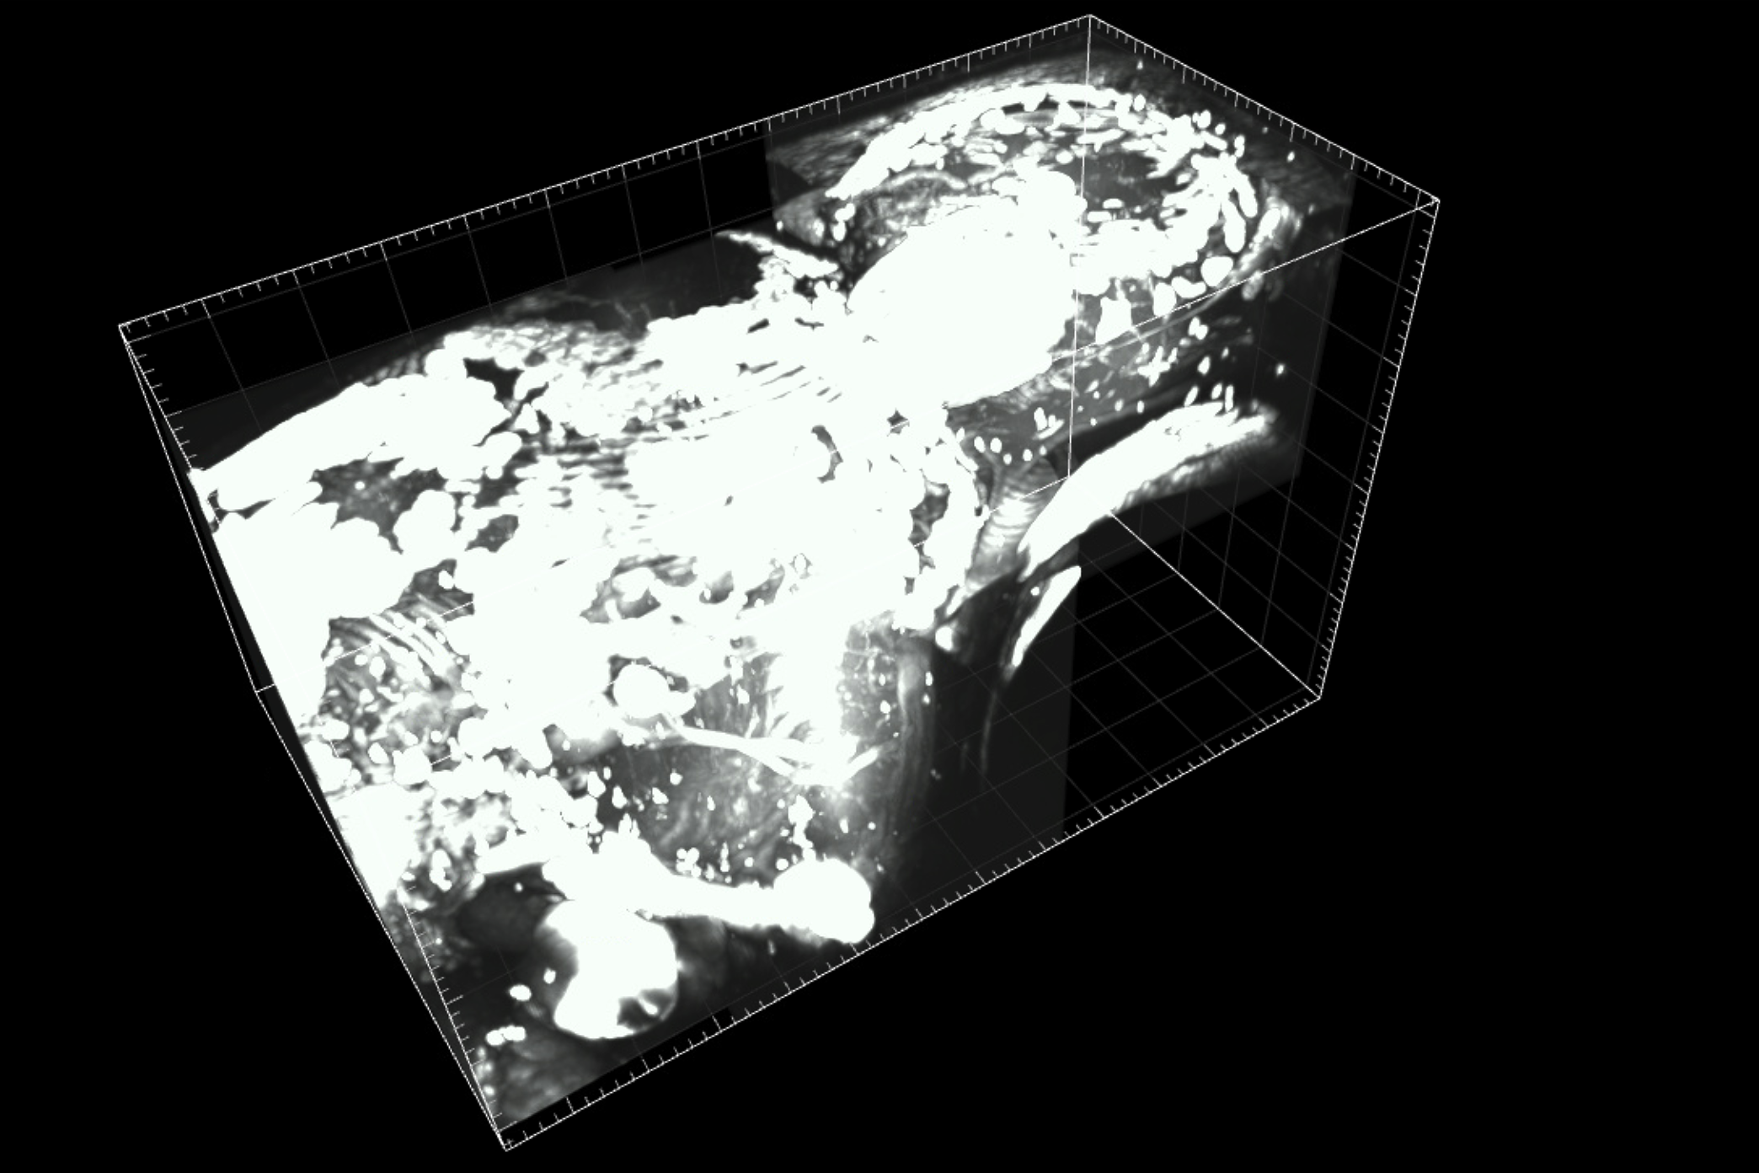
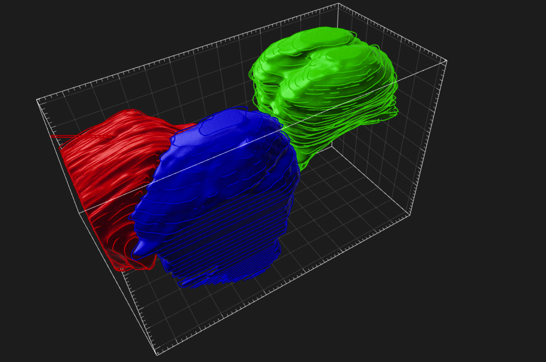
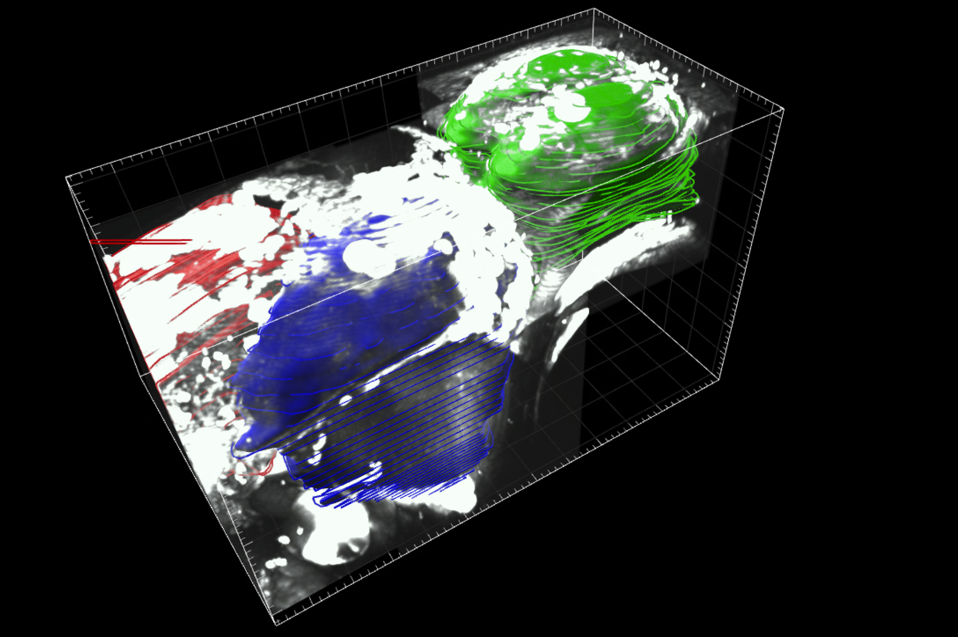
Over Saturation
Ear Chamber
Mesencephalon
Posterior Commisure
Medial Longitudinal Fascicle
Hind Brain
Hind Brain
Hind Brain
Ear Chamber
Mesencephalon
Ear Chamber
Mesencephalon
Shadow
Dorsal
Ventral
Cerebellum
Telencephalon
Telencephalon
Cerebellum
Optic Tectum
Cerebellum
Optic Tectum
Telencephalon
Dorsal
Rostral
Dorsal
Rostral
Dorsal
Rostral
Lateral
Lateral
Optic Tectum
Lateral
Raw THG Signal
Reconstructed Volumes
Overlay

